Slide 1
Measles and Rubella
Global Update
December 2025

Slide 2
Distribution list
This report is posted on the WHO Immunization data portal (https://immunizationdata.who.int/global?topic=Provisional-measles-and-rubella-data&location=) and distributed by email on a monthly basis.
To join the distribution list, please send an email to Sebastien Antoni (antonis@who.int)

Slide 3
Disclaimer
Please note that all data contained within is provisional. The number of cases of measles and rubella officially reported by a member state is only available by July of each year (through the joint WHO UNICEF annual data collection exercise). If any numbers from this provisional data are quoted, they should be properly sourced with a date (i.e. "provisional data based on monthly data reported to WHO (Geneva) as of December 2025"). For official data from 1980-2024, please visit our website.

Slide 4
Data sources and limitations

Slide 5
Measles

Slide 6
Number of reported measles cases by WHO Region
2025
Region | Member States* | Suspected MR cases | Measles cases | Clin | Epi | Lab | Date Received
AFR | 42/47 | 103,849 | 59,261 | 28,112 | 12,658 | 18,491 | 2025-12
AMR | 32/35 | 37,946 | 12,785 | 3 | 2,830 | 9,952 | 2025-12
EMR | 20/21 | 109,862 | 66,493 | 31,099 | 8,478 | 26,916 | 2025-12
EUR | 47/53 | 46,165 | 31,845 | 5,035 | 5,458 | 21,352 | 2025-12
SEAR | 10/10 | 94,738 | 16,875 | 5,470 | 3,091 | 8,314 | 2025-12
WPR | 28/28 | 102,927 | 37,315 | 7,917 | 13,897 | 15,501 | 2025-12
Total | 179/194 | 495,487 | 224,574 | 77,636 | 46,412 | 100,526
Region | Jan | Feb | Mar | Apr | May | Jun | Jul | Aug | Sep | Oct | Nov | Dec
AFR | 5,966 | 7,303 | 9,639 | 6,571 | 6,972 | 5,453 | 4,367 | 4,609 | 3,756 | 3,228 | 1,394 | 3
AMR | 207 | 434 | 1,221 | 2,516 | 2,177 | 1,883 | 1,657 | 880 | 729 | 590 | 491 | 0
EMR | 6,973 | 7,743 | 9,517 | 9,450 | 9,145 | 6,218 | 6,113 | 4,414 | 3,450 | 2,348 | 1,067 | 55
EUR | 4,900 | 4,459 | 4,632 | 5,275 | 5,275 | 3,858 | 1,777 | 802 | 476 | 356 | 35 | 0
SEAR | 1,409 | 1,615 | 2,107 | 2,168 | 1,709 | 1,296 | 1,332 | 913 | 1,349 | 1,651 | 1,326 | 0
WPR | 3,244 | 3,432 | 3,404 | 2,857 | 6,738 | 8,152 | 4,406 | 2,808 | 1,406 | 868 | 0 | 0
Total | 22,699 | 24,986 | 30,520 | 28,837 | 32,016 | 26,860 | 19,652 | 14,426 | 11,166 | 9,041 | 4,313 | 58
2024
Region | Member States* | Suspected MR cases | Measles cases | Clin | Epi | Lab | Date Received
AFR | 43/47 | 153,308 | 86,127 | 15,884 | 51,811 | 18,432 | 2025-12
AMR | 33/35 | 17,776 | 464 | 0 | 53 | 411 | 2025-12
EMR | 21/21 | 164,426 | 96,713 | 52,179 | 6,207 | 38,327 | 2025-12
EUR | 52/53 | 149,238 | 127,411 | 21,812 | 20,127 | 85,472 | 2025-12
SEAR | 10/10 | 133,179 | 29,532 | 7,995 | 6,657 | 14,880 | 2025-12
WPR | 28/28 | 91,820 | 19,202 | 7,893 | 986 | 10,323 | 2025-12
Total | 187/194 | 709,747 | 359,449 | 105,763 | 85,841 | 167,845
Region | Jan | Feb | Mar | Apr | May | Jun | Jul | Aug | Sep | Oct | Nov | Dec
AFR | 13,630 | 15,801 | 19,233 | 11,624 | 7,782 | 4,419 | 2,969 | 2,331 | 2,501 | 2,270 | 2,207 | 1,360
AMR | 23 | 49 | 103 | 47 | 18 | 19 | 41 | 39 | 37 | 33 | 44 | 11
EMR | 13,513 | 15,485 | 15,739 | 10,912 | 10,914 | 7,073 | 5,088 | 3,559 | 3,838 | 3,695 | 3,272 | 3,625
EUR | 29,073 | 24,206 | 20,550 | 15,700 | 12,920 | 9,445 | 5,174 | 2,415 | 1,502 | 1,391 | 2,018 | 3,017
SEAR | 2,760 | 3,040 | 4,027 | 2,928 | 2,183 | 1,342 | 1,840 | 2,204 | 2,563 | 2,913 | 2,206 | 1,526
WPR | 2,142 | 1,791 | 1,927 | 1,677 | 1,661 | 1,211 | 924 | 1,355 | 1,360 | 1,712 | 1,816 | 1,626
Total | 61,141 | 60,372 | 61,579 | 42,888 | 35,478 | 23,509 | 16,036 | 11,903 | 11,801 | 12,014 | 11,563 | 11,165
Notes: Based on data received 2025-12 - This is surveillance data, hence for the last month, the data may be incomplete. * Member States Reporting / Total Member States in Region

Slide 7
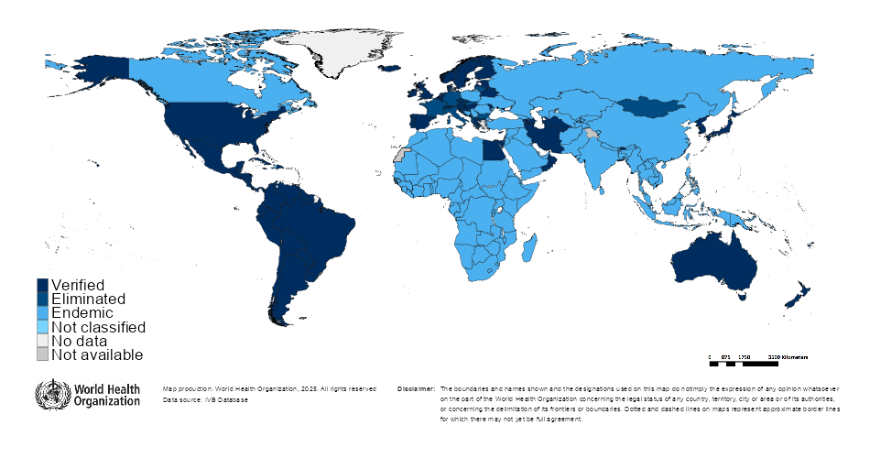

Measles/rubella verification of elimination
Measles
Region | Member States | Verified | % Verified | Eliminated | Endemic* | Not classified
AFR | 47 | 3 | 6 | 0 | 44 | 0
AMR | 35 | 33 | 94 | 0 | 1 | 1
EMR | 21 | 4 | 19 | 0 | 17 | 0
EUR | 53 | 33 | 62 | 8 | 12 | 0
SEAR | 10 | 4 | 40 | 0 | 6 | 0
WPR | 28 | 19 | 68 | 1 | 8 | 0
GLOBAL | 194 | 96 | 49 | 9 | 88 | 1
Rubella
Region | Member States | Verified | % Verified | Eliminated | Endemic* | Not classified
AFR | 47 | 3 | 6 | 0 | 44 | 0
AMR | 35 | 34 | 97 | 0 | 0 | 1
EMR | 21 | 4 | 19 | 0 | 17 | 0
EUR | 53 | 50 | 94 | 0 | 0 | 3
SEAR | 10 | 6 | 60 | 0 | 4 | 0
WPR | 28 | 19 | 68 | 2 | 7 | 0
GLOBAL | 194 | 116 | 60 | 2 | 72 | 4
Notes: Based on data available at WHO HQ as of 2025-12-10 . Terms used on this slide refer to the global framework for the verification of measles and rubella elimination. These terms might differ from those used by WHO Regional Offices. Verified = Elimination verified by Regional Verification Commission (RVC); Eliminated = Eliminated transmission but no RVC verification yet; *The endemic category on this slide also includes countries where transmission was reestablished.

Slide 8
Measles case distribution by month and WHO Region (2020-2025)
2020
2021
2022
2023
2024
2025
93,840 cases
59,619 cases
176,408 cases
321,876 cases
359,449 cases
224,574 cases
60,000
40,000
AFR
AMR
EMR
EUR
SEAR
WPR
20,000
0
Jan
Feb
Mar
Apr
May
Jun
Jul
Aug
Sep
Oct
Nov
Dec
Jan
Feb
Mar
Apr
May
Jun
Jul
Aug
Sep
Oct
Nov
Dec
Jan
Feb
Mar
Apr
May
Jun
Jul
Aug
Sep
Oct
Nov
Dec
Jan
Feb
Mar
Apr
May
Jun
Jul
Aug
Sep
Oct
Nov
Dec
Jan
Feb
Mar
Apr
May
Jun
Jul
Aug
Sep
Oct
Nov
Dec
Jan
Feb
Mar
Apr
May
Jun
Jul
Aug
Sep
Oct
Nov
Dec
Based on data received 2025-12 - Data Source: IVB Database - This is surveillance data, hence for the last month(s), the data may be incomplete.

Slide 9
Measles case distribution by month and WHO Region (2017-2025)
2017
2018
2019
2020
2021
2022
2023
2024
2025
168,190 cases
276,156 cases
541,401 cases
93,840 cases
59,619 cases
176,408 cases
321,876 cases
359,449 cases
224,574 cases
125,000
100,000
AFR
75,000
AMR
EMR
EUR
SEAR
50,000
WPR
25,000
0
May
Aug
Sep
May
Aug
Sep
May
Aug
Sep
May
Aug
Sep
May
Aug
Sep
May
Aug
Sep
May
Aug
Sep
May
Aug
Sep
May
Aug
Sep
Jan
Feb
Apr
Jun
Jul
Oct
Jan
Apr
Jun
Jul
Oct
Jan
Apr
Jun
Jul
Oct
Jan
Apr
Jun
Jul
Oct
Jan
Apr
Jun
Jul
Oct
Jan
Apr
Jun
Jul
Oct
Jan
Apr
Jun
Jul
Oct
Jan
Apr
Jun
Jul
Oct
Jan
Apr
Jun
Jul
Oct
Mar
Nov
Dec
Feb
Mar
Nov
Dec
Feb
Mar
Nov
Dec
Feb
Mar
Nov
Dec
Feb
Mar
Nov
Dec
Feb
Mar
Nov
Dec
Feb
Mar
Nov
Dec
Feb
Mar
Nov
Dec
Feb
Mar
Nov
Dec
Based on data received 2025-12 - Data Source: IVB Database - This is surveillance data, hence for the last month(s), the data may be incomplete.

Slide 10
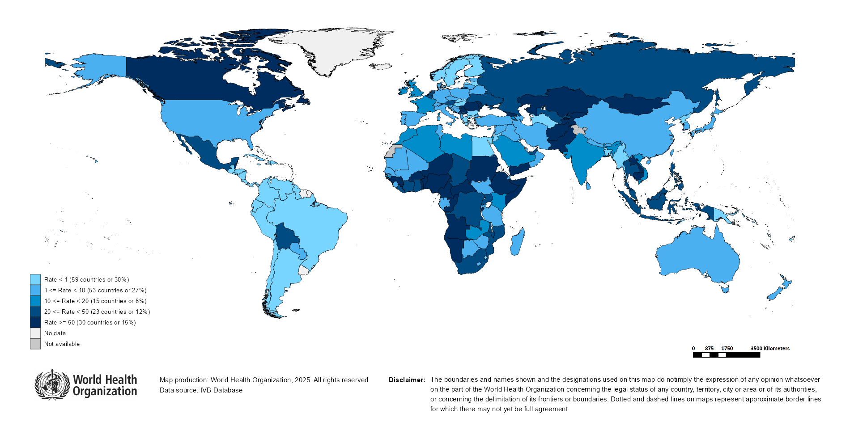
Measles Incidence Rate per Million (12M period)
Highest incidence rates | Highest incidence rates | Highest incidence rates
Country | Cases | Rate
Mongolia | 13354 | 3,842.28
Kyrgyzstan | 9854 | 1,371.28
Yemen | 30549 | 752.75
Lao People's Democratic Republic | 2589 | 333.21
Romania | 5954 | 313.12
Afghanistan | 10679 | 250.40
Tajikistan | 2325 | 219.53
Angola | 7479 | 197.41
Georgia | 587 | 154.16
Kazakhstan | 2978 | 144.62
Notes: Based on data received 2025-12 - Surveillance data from 2024-11 to 2025-10 - Incidence: Number of cases / population * 1,000,000 - Population data: World population prospects, 2019 revision

Slide 11
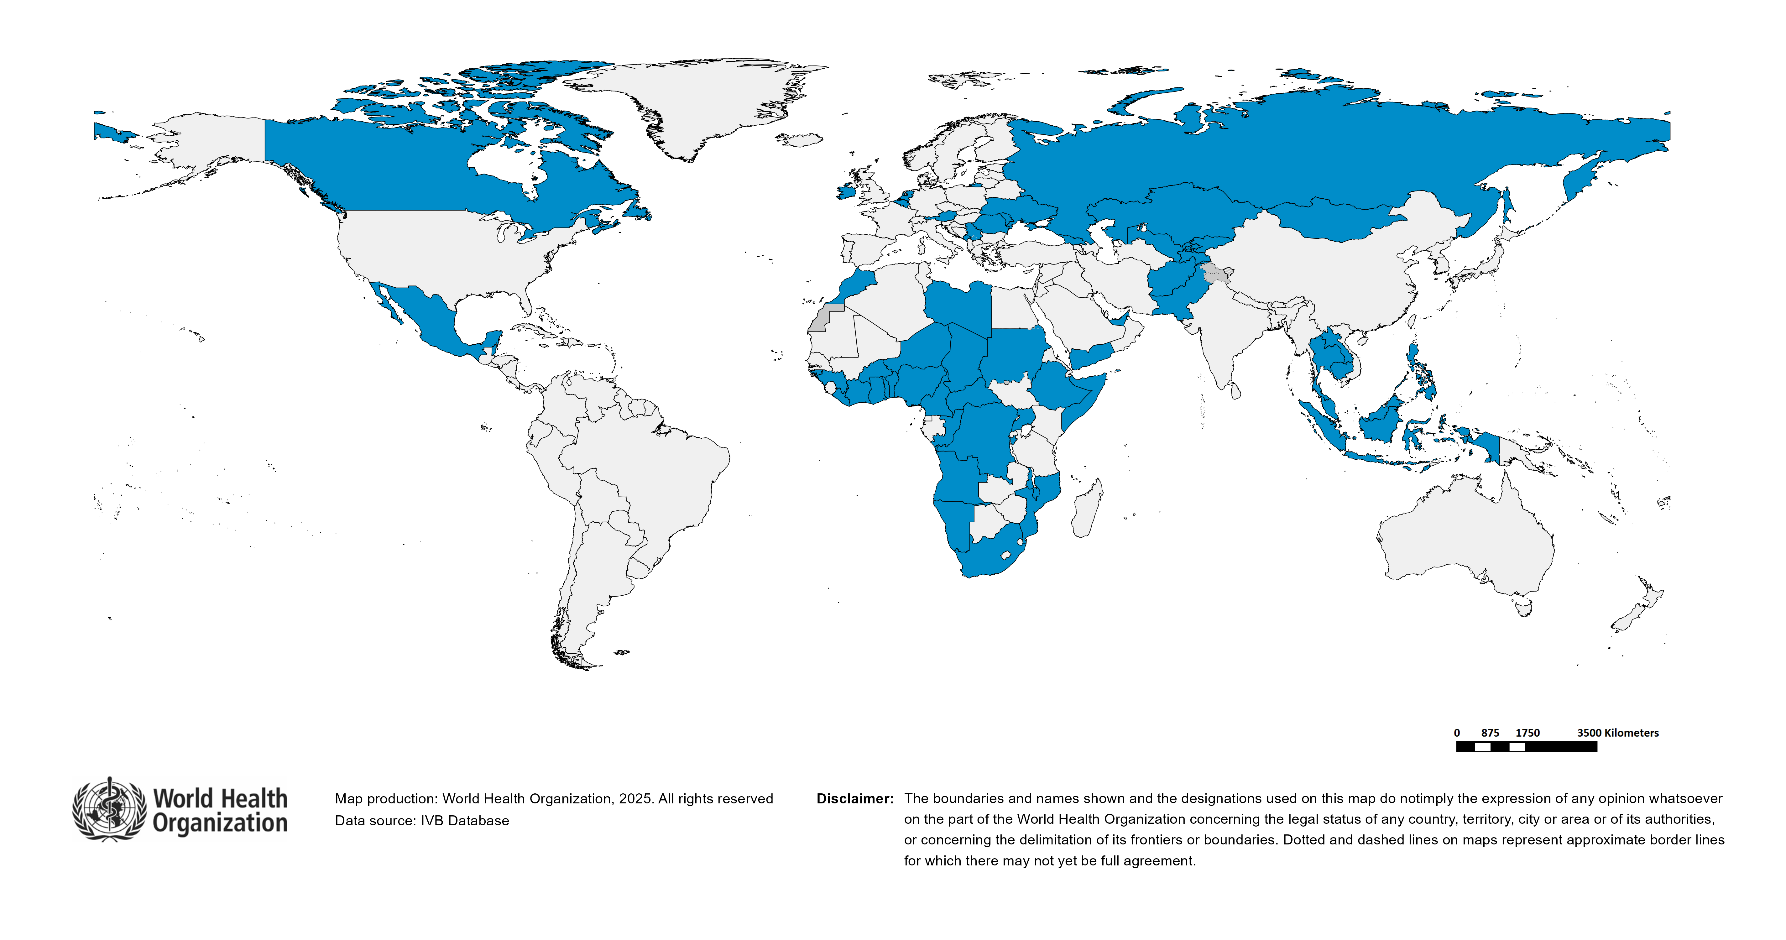
Immunization Agenda 2030 - Impact Goal 1.3
Countries provisionally meeting the large or disruptive outbreaks definition - Data from 2024-08 to 2025-07 included
Country | Cases | Rate/M | Clinical*
Mongolia | 12,466 | 3,544.40 | 0%
Kyrgyzstan | 10,131 | 1,388.75 | 43%
Yemen | 32,047 | 767.15 | 92%
Romania | 7,883 | 416.90 | 4%
Afghanistan | 11,104 | 253.26 | 0%
Tajikistan | 2,270 | 210.44 | 0%
Georgia | 707 | 185.73 | 12%
Lao People's Democratic Republic | 1,155 | 146.70 | 1%
Kazakhstan | 2,849 | 136.68 | 6%
Serbia | 819 | 122.44 | 50%
Canada | 4,454 | 111.00 | 0%
Cambodia | 1,760 | 98.61 | 0%
Togo | 949 | 97.62 | 3%
Thailand | 6,842 | 95.53 | 41%
Sudan | 4,894 | 94.73 | 2%
Burkina Faso | 2,249 | 93.42 | 78%
Angola | 3,351 | 85.83 | 63%
Somalia | 1,667 | 84.81 | 0%
Republic of Moldova | 254 | 84.78 | 2%
Congo | 540 | 83.28 | 2%
Nigeria | 19,334 | 81.40 | 74%
Belize | 34 | 80.39 | 6%
Liberia | 459 | 80.09 | 2%
Pakistan | 20,242 | 79.31 | 23%
Central African Republic | 424 | 76.91 | 2%
Niger | 2,066 | 74.00 | 50%
Benin | 1,011 | 68.24 | 40%
Cameroon | 2,012 | 67.34 | 7%
Country | Cases | Rate/M | Clinical*
Ethiopia | 8,854 | 65.36 | 1%
Guinea | 864 | 57.22 | 13%
Burundi | 778 | 54.07 | 4%
Montenegro | 34 | 53.74 | 0%
Indonesia | 14,672 | 51.35 | 39%
Ghana | 1,741 | 49.65 | 65%
Russian Federation | 7,001 | 48.62 | 0%
Ukraine | 1,665 | 42.71 | 8%
Côte d'Ivoire | 1,345 | 41.12 | 0%
Malawi | 906 | 40.78 | 7%
Malaysia | 1,352 | 37.58 | 15%
Philippines | 4,337 | 37.14 | 74%
Belgium | 398 | 33.85 | 9%
Ireland | 169 | 31.84 | 1%
Mexico | 4,031 | 30.55 | 0%
Netherlands (Kingdom of the) | 557 | 30.36 | 0%
DR Congo | 3,308 | 29.32 | 4%
Uzbekistan | 959 | 25.88 | 1%
Libya | 189 | 25.34 | 0%
Guinea-Bissau | 56 | 24.89 | 39%
Uganda | 1,204 | 23.43 | 5%
South Africa | 1,502 | 23.20 | 14%
Namibia | 71 | 22.96 | 80%
Mozambique | 795 | 22.31 | 48%
Chad | 456 | 21.71 | 5%
Morocco | 827 | 21.52 | 14%
Austria | 192 | 21.07 | 0%
United Arab Emirates | 231 | 20.36 | 18%
Total: 56 countries
In the frame of tracking progress towards the goals of Immunization Agenda 2030 (IA2030), an indicator has been developed by a working group in order to represent large or disruptive measles outbreaks. This indicator is defined as an incidence equal or greater than 20 reported measles cases per million population over a period of 12 months. It is important to note that measles outbreak definitions vary between countries and regions according to local context and level of progress towards regional elimination goals. This definition of large or disruptive outbreaks aims to complement and not replace the national and regional definitions, while also providing a degree of global standardization and permitting tracking of progress against a common metric.
Notes: Based on data received 2025-12 and covering the period between 2024-08 and 2025-07 - Incidence: Number of cases / 1M population - Population Data: World population prospects, 2019 revision - A high proportion of clinical cases indicates a high level of uncertainty associated with the incidence rates and the inclusion of countries in this list.

Slide 12
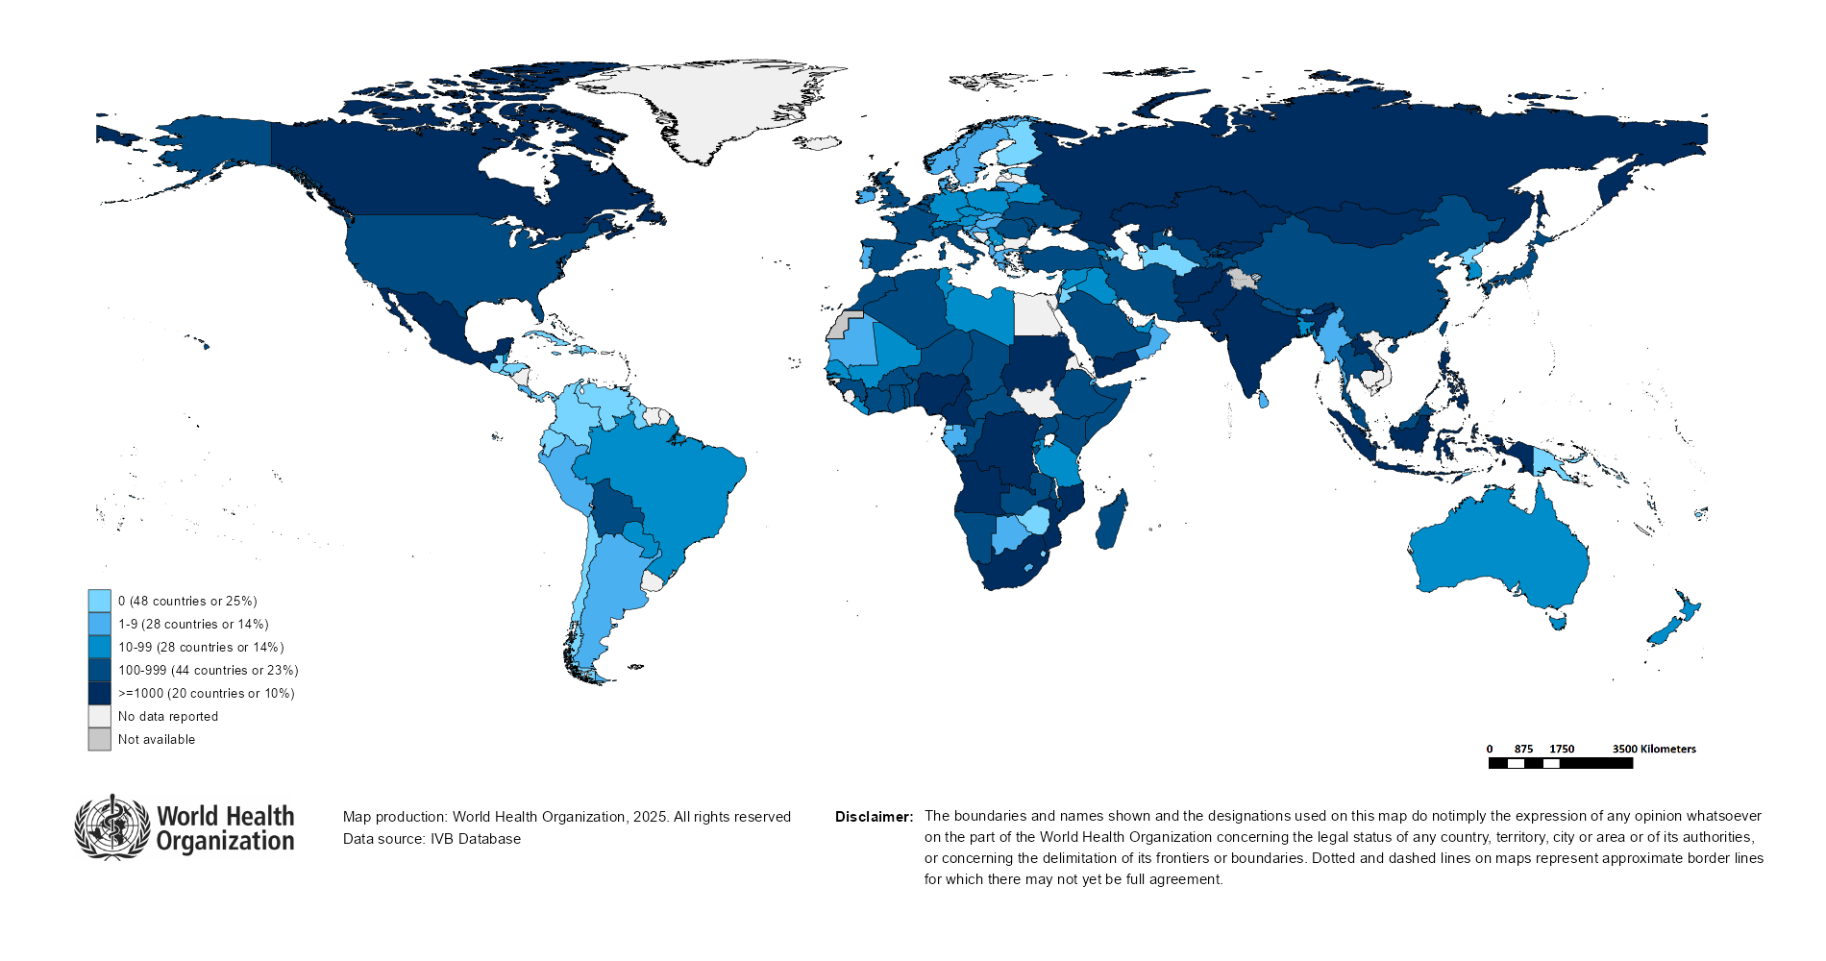
Number of Reported Measles Cases (Last 6 months)
Country | Cases*
Yemen | 13,417
Mongolia | 12,172
Pakistan | 10,158
Nigeria | 8,820
India** | 7,806
Angola | 6,690
Indonesia | 6,033
Russian Federation | 4,184
Mexico | 3,717
Afghanistan | 3,429
Notes: Based on data received 2025-12 - Surveillance data from 2025-05 to 2025-10 - * Countries with highest number of cases for the period - **WHO classifies all suspected measles cases reported from India as measles clinically compatible if a specimen was not collected as per the algorithm for classification of suspected measles in the WHO VPD Surveillance Standards. Thus numbers might be different between what WHO reports and what India reports.

Slide 13
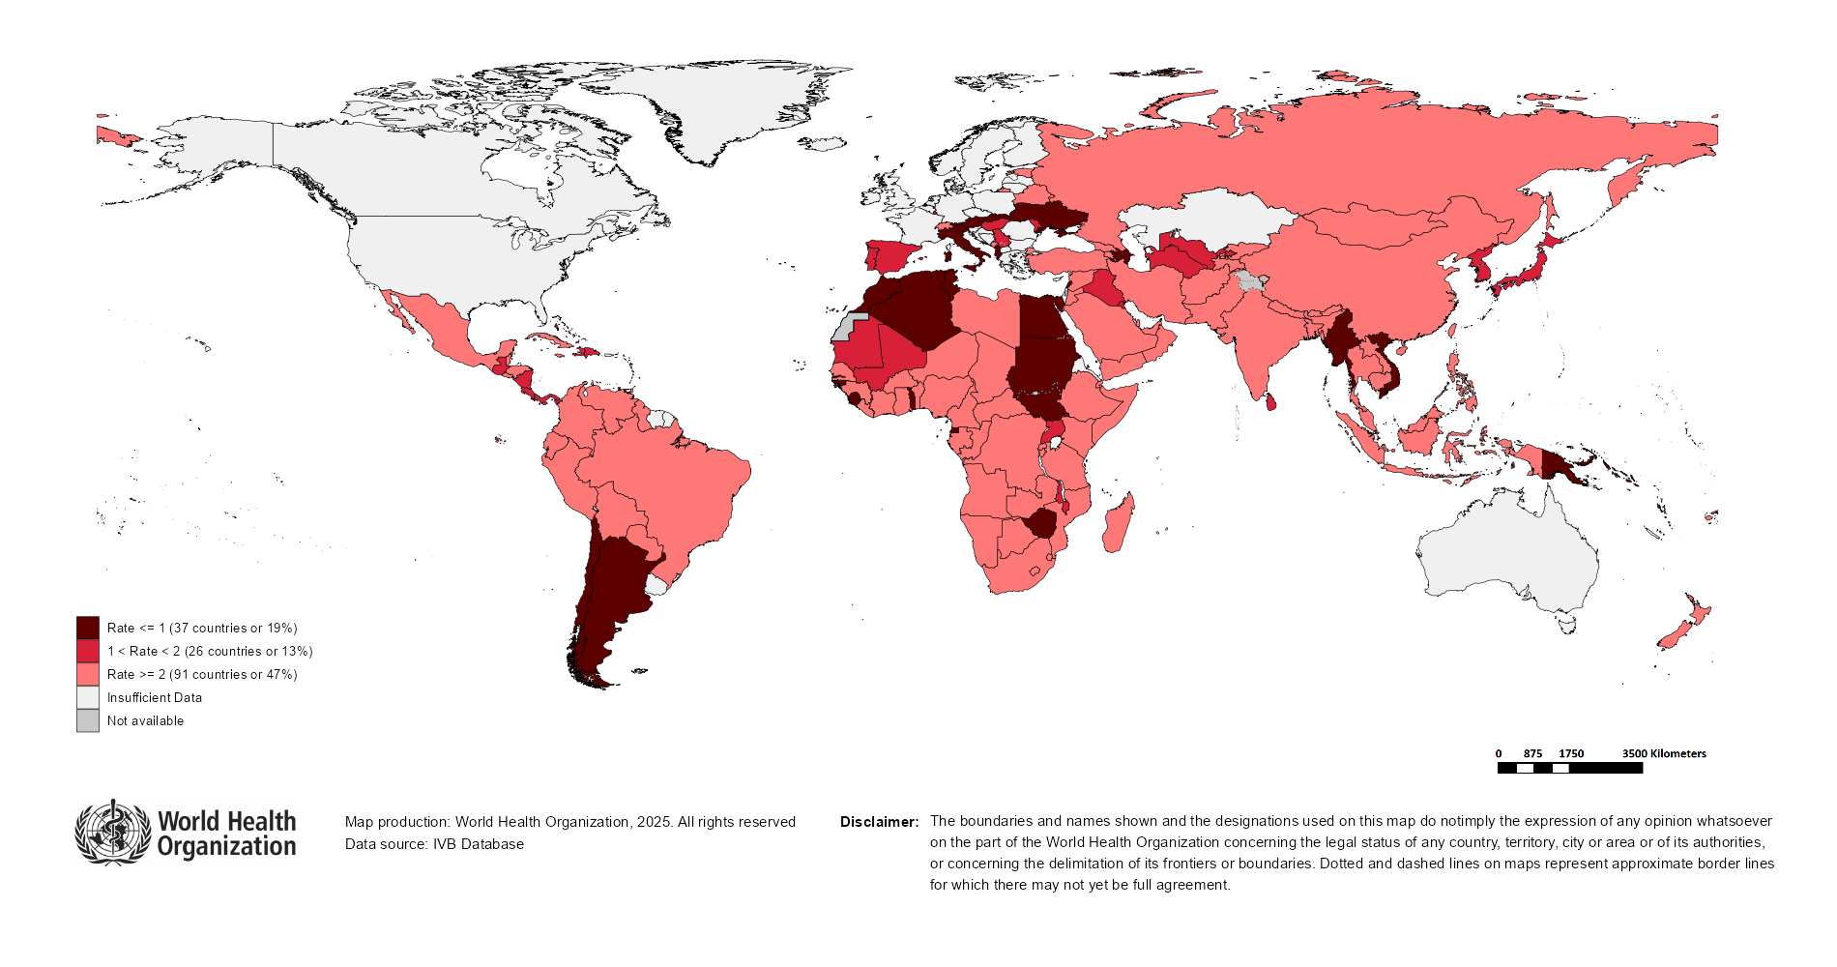
Surveillance sensitivity reporting rate of measles and rubella (12 months, discarded cases* per 100,000 population)
Notes: Based on data received 2025-12 - Surveillance data from 2024-11 to 2025-10 - Target: >= 2 discarded cases* / 100,000 population** - * Suspected cases investigated and discarded as non-measles non-rubella using laboratory testing and/or epidemiological linkage to another etiology ** World population prospects, 2019 revision

Slide 14
Disclaimer
This document contains data provided to WHO by member states. Note that some member states only provide aggregate data to WHO, and for these, we are unable to generate a country profile. Some member states report all cases at one time point for the entire year, and thus epidemiologic curves generated are not accurate and a reporting artifact. For some countries, cases are reported by age category, not by exact age in months and/or years. Thus, age distribution/incidence is approximate. Cases classified as pending by countries are classified at WHO as clinically compatible at this time, and thus numbers might different between data shown here and provided by the member state or WHO country/regional offices.
*UN population data is used as the denominator for calculating incidence.

Slide 15
Measles case distribution (AFR), 2020-2025
2020
2021
2022
2023
2024
2025
20,000
46,747 cases
26,492 cases
66,990 cases
73,443 cases
86,127 cases
59,261 cases
15,000
10,000
5,000
0
Jan
Feb
Mar
Apr
May
Jun
Jul
Aug
Sep
Oct
Nov
Dec
Jan
Feb
Mar
Apr
May
Jun
Jul
Aug
Sep
Oct
Nov
Dec
Jan
Feb
Mar
Apr
May
Jun
Jul
Aug
Sep
Oct
Nov
Dec
Jan
Feb
Mar
Apr
May
Jun
Jul
Aug
Sep
Oct
Nov
Dec
Jan
Feb
Mar
Apr
May
Jun
Jul
Aug
Sep
Oct
Nov
Dec
Jan
Feb
Mar
Apr
May
Jun
Jul
Aug
Sep
Oct
Nov
Dec
Angola
Cameroon
DR Congo
Ethiopia
Nigeria
Others
Based on data received 2025-12 - Data Source: IVB Database

Slide 16
Measles cases: Algeria
ELIMINATION STATUS:
ENDEMIC
2021
2022
2023
2024
2025
Total: 37 case(s)
Total: 5 case(s)
Total: 27 case(s)
Total: 76 case(s)
Total: 624 case(s)
Discarded
Not reported
JRF: 47 case(s)
JRF: 203 case(s)
JRF: 488 case(s)
Clinical
100
Epi
Lab
Number of measles cases
50
0
Jan
Feb
Mar
Apr
May
Jun
Jul
Aug
Sep
Oct
Nov
Dec
Jan
Feb
Mar
Apr
May
Jun
Jul
Aug
Sep
Oct
Nov
Dec
Jan
Feb
Mar
Apr
May
Jun
Jul
Aug
Sep
Oct
Nov
Dec
Jan
Feb
Mar
Apr
May
Jun
Jul
Aug
Sep
Oct
Nov
Dec
Jan
Feb
Mar
Apr
May
Jun
Jul
Aug
Sep
Oct
Nov
Dec
Age distribution, vaccination status and incidence (last 12 months)
WHO/UNICEF Coverage Estimates (WUENIC)
150
100
150
80
100
100
60
Number of cases
Incidence rate per M
50
% Coverage
50
40
0
0
20
<1 yr
1-4 yrs
5-9 yrs
10-14 yrs
15-24 yrs
25-39 yrs
40+ yrs
0
Age at onset (in years)
2000
2001
2002
2003
2004
2005
2006
2007
2008
2009
2010
2011
2012
2013
2014
2015
2016
2017
2018
2019
2020
2021
2022
2023
2024
Incidence
1 dose
Unknown
MCV1
MCV2
Based on data received 2025-12 - Data Source: IVB Database. Main epi curve was built using case-based surveillance data. Age distribution curve was built using case-based surveillance data. Coverage data from WHO/UNICEF Estimates of National Immunization Coverage (WUENIC)

Slide 17
Measles cases: Angola
ELIMINATION STATUS:
ENDEMIC
2,000
2021
2022
2023
2024
2025
Total: 335 case(s)
Total: 3,263 case(s)
Total: 2,475 case(s)
Total: 568 case(s)
Total: 7,956 case(s)
Discarded
JRF: 300 case(s)
JRF: 3,271 case(s)
JRF: 3,508 case(s)
JRF: 619 case(s)
Clinical
1,500
Epi
Lab
1,000
Number of measles cases
500
0
Jan
Feb
Mar
Apr
May
Jun
Jul
Aug
Sep
Oct
Nov
Dec
Jan
Feb
Mar
Apr
May
Jun
Jul
Aug
Sep
Oct
Nov
Dec
Jan
Feb
Mar
Apr
May
Jun
Jul
Aug
Sep
Oct
Nov
Dec
Jan
Feb
Mar
Apr
May
Jun
Jul
Aug
Sep
Oct
Nov
Dec
Jan
Feb
Mar
Apr
May
Jun
Jul
Aug
Sep
Oct
Nov
Dec
Age distribution, vaccination status and incidence (last 12 months)
WHO/UNICEF Coverage Estimates (WUENIC)
100
3,000
80
1000
Number of cases
2,000
Incidence rate per M
60
500
% Coverage
1,000
40
0
0
20
<1 yr
1-4 yrs
5-9 yrs
10-14 yrs
15-24 yrs
25-39 yrs
40+ yrs
0
Age at onset (in years)
2000
2001
2002
2003
2004
2005
2006
2007
2008
2009
2010
2011
2012
2013
2014
2015
2016
2017
2018
2019
2020
2021
2022
2023
2024
Incidence
Unknown
MCV1
MCV2
Based on data received 2025-12 - Data Source: IVB Database. Main epi curve was built using case-based surveillance data. Age distribution curve was built using case-based surveillance data. Coverage data from WHO/UNICEF Estimates of National Immunization Coverage (WUENIC)

Slide 18
Measles cases: Democratic Republic of the Congo
ELIMINATION STATUS:
ENDEMIC
2021
2022
2023
2024
2025
3,000
Total: 3,443 case(s)
Total: 4,343 case(s)
Total: 10,701 case(s)
Total: 5,086 case(s)
Total: 3,546 case(s)
SIA
JRF: 54,471 case(s)
JRF: 4,380 case(s)
JRF: 311,500 case(s)
JRF: 109,419 case(s)
Discarded
2,000
Clinical
Epi
Number of measles cases
Lab
1,000
0
Jan
Feb
Mar
Apr
May
Jun
Jul
Aug
Sep
Oct
Nov
Dec
Jan
Feb
Mar
Apr
May
Jun
Jul
Aug
Sep
Oct
Nov
Dec
Jan
Feb
Mar
Apr
May
Jun
Jul
Aug
Sep
Oct
Nov
Dec
Jan
Feb
Mar
Apr
May
Jun
Jul
Aug
Sep
Oct
Nov
Dec
Jan
Feb
Mar
Apr
May
Jun
Jul
Aug
Sep
Oct
Nov
Dec
Age distribution, vaccination status and incidence (last 12 months)
WHO/UNICEF Coverage Estimates (WUENIC)
2,000
100
1,500
150
80
100
60
Number of cases
1,000
Incidence rate per M
% Coverage
500
50
40
0
0
20
<1 yr
1-4 yrs
5-9 yrs
10-14 yrs
15-24 yrs
25-39 yrs
40+ yrs
0
Age at onset (in years)
2000
2001
2002
2003
2004
2005
2006
2007
2008
2009
2010
2011
2012
2013
2014
2015
2016
2017
2018
2019
2020
2021
2022
2023
2024
Incidence
2+ doses
1 dose
0 doses
Unknown
MCV1
MCV2
Based on data received 2025-12 - Data Source: IVB Database. Main epi curve was built using case-based surveillance data. Age distribution curve was built using case-based surveillance data. Coverage data from WHO/UNICEF Estimates of National Immunization Coverage (WUENIC)

Slide 19
Measles cases: Ethiopia
ELIMINATION STATUS:
ENDEMIC
2021
2022
2023
2024
2025
Total: 1,947 case(s)
Total: 9,253 case(s)
Total: 16,505 case(s)
Total: 30,201 case(s)
Total: 5,337 case(s)
SIA
8,000
JRF: 1,953 case(s)
JRF: 9,292 case(s)
JRF: 24,038 case(s)
JRF: 31,044 case(s)
Discarded
6,000
Clinical
Epi
Number of measles cases
Lab
4,000
2,000
0
Jan
Feb
Mar
Apr
May
Jun
Jul
Aug
Sep
Oct
Nov
Dec
Jan
Feb
Mar
Apr
May
Jun
Jul
Aug
Sep
Oct
Nov
Dec
Jan
Feb
Mar
Apr
May
Jun
Jul
Aug
Sep
Oct
Nov
Dec
Jan
Feb
Mar
Apr
May
Jun
Jul
Aug
Sep
Oct
Nov
Dec
Jan
Feb
Mar
Apr
May
Jun
Jul
Aug
Sep
Oct
Nov
Dec
Age distribution, vaccination status and incidence (last 12 months)
WHO/UNICEF Coverage Estimates (WUENIC)
3,000
200
100
2,000
150
80
Number of cases
Incidence rate per M
60
100
% Coverage
1,000
40
50
0
0
20
<1 yr
1-4 yrs
5-9 yrs
10-14 yrs
15-24 yrs
25-39 yrs
40+ yrs
0
Age at onset (in years)
2000
2001
2002
2003
2004
2005
2006
2007
2008
2009
2010
2011
2012
2013
2014
2015
2016
2017
2018
2019
2020
2021
2022
2023
2024
Incidence
2+ doses
1 dose
0 doses
Unknown
MCV1
MCV2
Based on data received 2025-12 - Data Source: IVB Database. Main epi curve was built using case-based surveillance data. Age distribution curve was built using case-based surveillance data. Coverage data from WHO/UNICEF Estimates of National Immunization Coverage (WUENIC)

Slide 20
Measles cases: Malawi
ELIMINATION STATUS:
ENDEMIC
2021
2022
2023
2024
2025
300
Total: 43 case(s)
Total: 54 case(s)
Total: 161 case(s)
Total: 180 case(s)
Total: 1,013 case(s)
SIA
JRF: 5 case(s)
JRF: 29 case(s)
JRF: 173 case(s)
JRF: 958 case(s)
Discarded
200
Clinical
Epi
Number of measles cases
Lab
100
0
Jan
Feb
Mar
Apr
May
Jun
Jul
Aug
Sep
Oct
Nov
Dec
Jan
Feb
Mar
Apr
May
Jun
Jul
Aug
Sep
Oct
Nov
Dec
Jan
Feb
Mar
Apr
May
Jun
Jul
Aug
Sep
Oct
Nov
Dec
Jan
Feb
Mar
Apr
May
Jun
Jul
Aug
Sep
Oct
Nov
Dec
Jan
Feb
Mar
Apr
May
Jun
Jul
Aug
Sep
Oct
Nov
Dec
Age distribution, vaccination status and incidence (last 12 months)
WHO/UNICEF Coverage Estimates (WUENIC)
60
100
100
40
80
Number of cases
Incidence rate per M
60
50
20
% Coverage
40
0
0
20
<1 yr
1-4 yrs
5-9 yrs
10-14 yrs
15-24 yrs
25-39 yrs
40+ yrs
0
Age at onset (in years)
2000
2001
2002
2003
2004
2005
2006
2007
2008
2009
2010
2011
2012
2013
2014
2015
2016
2017
2018
2019
2020
2021
2022
2023
2024
Incidence
2+ doses
1 dose
0 doses
Unknown
MCV1
MCV2
Based on data received 2025-12 - Data Source: IVB Database. Main epi curve was built using case-based surveillance data. Age distribution curve was built using case-based surveillance data. Coverage data from WHO/UNICEF Estimates of National Immunization Coverage (WUENIC)

Slide 21
Measles cases: Namibia
ELIMINATION STATUS:
ENDEMIC
250
2021
2022
2023
2024
2025
Total: 8 case(s)
Total: 59 case(s)
Total: 41 case(s)
Total: 74 case(s)
Total: 268 case(s)
SIA
JRF: 4 case(s)
JRF: 31 case(s)
JRF: 42 case(s)
JRF: 15 case(s)
200
Discarded
150
Clinical
Epi
Number of measles cases
Lab
100
50
0
Jan
Feb
Mar
Apr
May
Jun
Jul
Aug
Sep
Oct
Nov
Dec
Jan
Feb
Mar
Apr
May
Jun
Jul
Aug
Sep
Oct
Nov
Dec
Jan
Feb
Mar
Apr
May
Jun
Jul
Aug
Sep
Oct
Nov
Dec
Jan
Feb
Mar
Apr
May
Jun
Jul
Aug
Sep
Oct
Nov
Dec
Jan
Feb
Mar
Apr
May
Jun
Jul
Aug
Sep
Oct
Nov
Dec
Age distribution, vaccination status and incidence (last 12 months)
WHO/UNICEF Coverage Estimates (WUENIC)
100
400
100
75
300
80
Incidence rate per M
60
Number of cases
200
50
% Coverage
25
100
40
0
0
20
<1 yr
1-4 yrs
5-9 yrs
10-14 yrs
15-24 yrs
25-39 yrs
40+ yrs
0
Age at onset (in years)
2000
2001
2002
2003
2004
2005
2006
2007
2008
2009
2010
2011
2012
2013
2014
2015
2016
2017
2018
2019
2020
2021
2022
2023
2024
Incidence
2+ doses
1 dose
0 doses
Unknown
MCV1
MCV2
Based on data received 2025-12 - Data Source: IVB Database. Main epi curve was built using case-based surveillance data. Age distribution curve was built using case-based surveillance data. Coverage data from WHO/UNICEF Estimates of National Immunization Coverage (WUENIC)

Slide 22
Measles cases: Nigeria
ELIMINATION STATUS:
ENDEMIC
2021
2022
2023
2024
2025
Total: 10,871 case(s)
Total: 20,748 case(s)
Total: 12,224 case(s)
Total: 10,948 case(s)
Total: 20,424 case(s)
SIA
8,000
JRF: 10,649 case(s)
JRF: 23,983 case(s)
JRF: 20,143 case(s)
JRF: 14,999 case(s)
Discarded
6,000
Clinical
Epi
Number of measles cases
Lab
4,000
2,000
0
Jan
Feb
Mar
Apr
May
Jun
Jul
Aug
Sep
Oct
Nov
Dec
Jan
Feb
Mar
Apr
May
Jun
Jul
Aug
Sep
Oct
Nov
Dec
Jan
Feb
Mar
Apr
May
Jun
Jul
Aug
Sep
Oct
Nov
Dec
Jan
Feb
Mar
Apr
May
Jun
Jul
Aug
Sep
Oct
Nov
Dec
Jan
Feb
Mar
Apr
May
Jun
Jul
Aug
Sep
Oct
Nov
Dec
Age distribution, vaccination status and incidence (last 12 months)
WHO/UNICEF Coverage Estimates (WUENIC)
8,000
300
100
6,000
80
4,000
200
60
Number of cases
Incidence rate per M
100
% Coverage
2,000
40
0
0
20
<1 yr
1-4 yrs
5-9 yrs
10-14 yrs
15-24 yrs
25-39 yrs
40+ yrs
0
Age at onset (in years)
2000
2001
2002
2003
2004
2005
2006
2007
2008
2009
2010
2011
2012
2013
2014
2015
2016
2017
2018
2019
2020
2021
2022
2023
2024
Incidence
2+ doses
1 dose
0 doses
Unknown
MCV1
MCV2
Based on data received 2025-12 - Data Source: IVB Database. Main epi curve was built using case-based surveillance data. Age distribution curve was built using case-based surveillance data. Coverage data from WHO/UNICEF Estimates of National Immunization Coverage (WUENIC)

Slide 23
Measles cases: Uganda
ELIMINATION STATUS:
ENDEMIC
2021
2022
2023
2024
2025
400
Total: 68 case(s)
Total: 188 case(s)
Total: 401 case(s)
Total: 1,071 case(s)
Total: 1,011 case(s)
Discarded
JRF: 606 case(s)
JRF: 52 case(s)
JRF: 399 case(s)
JRF: 2,180 case(s)
Clinical
Epi
300
Lab
Number of measles cases
200
100
0
Jan
Feb
Mar
Apr
May
Jun
Jul
Aug
Sep
Oct
Nov
Dec
Jan
Feb
Mar
Apr
May
Jun
Jul
Aug
Sep
Oct
Nov
Dec
Jan
Feb
Mar
Apr
May
Jun
Jul
Aug
Sep
Oct
Nov
Dec
Jan
Feb
Mar
Apr
May
Jun
Jul
Aug
Sep
Oct
Nov
Dec
Jan
Feb
Mar
Apr
May
Jun
Jul
Aug
Sep
Oct
Nov
Dec
Age distribution, vaccination status and incidence (last 12 months)
WHO/UNICEF Coverage Estimates (WUENIC)
200
100
400
150
80
Incidence rate per M
60
Number of cases
100
% Coverage
200
40
50
0
0
20
<1 yr
1-4 yrs
5-9 yrs
10-14 yrs
15-24 yrs
25-39 yrs
40+ yrs
0
Age at onset (in years)
2000
2001
2002
2003
2004
2005
2006
2007
2008
2009
2010
2011
2012
2013
2014
2015
2016
2017
2018
2019
2020
2021
2022
2023
2024
Incidence
2+ doses
1 dose
0 doses
Unknown
MCV1
MCV2
Based on data received 2025-12 - Data Source: IVB Database. Main epi curve was built using case-based surveillance data. Age distribution curve was built using case-based surveillance data. Coverage data from WHO/UNICEF Estimates of National Immunization Coverage (WUENIC)

Slide 24
Measles case distribution (AMR), 2020-2025
2020
2021
2022
2023
2024
2025
8,708 cases
712 cases
169 cases
73 cases
464 cases
12,785 cases
3,000
2,000
1,000
0
Jan
Feb
Mar
Apr
May
Jun
Jul
Aug
Sep
Oct
Nov
Dec
Jan
Feb
Mar
Apr
May
Jun
Jul
Aug
Sep
Oct
Nov
Dec
Jan
Feb
Mar
Apr
May
Jun
Jul
Aug
Sep
Oct
Nov
Dec
Jan
Feb
Mar
Apr
May
Jun
Jul
Aug
Sep
Oct
Nov
Dec
Jan
Feb
Mar
Apr
May
Jun
Jul
Aug
Sep
Oct
Nov
Dec
Jan
Feb
Mar
Apr
May
Jun
Jul
Aug
Sep
Oct
Nov
Dec
Bolivia (Plurinational State of)
Brazil
Canada
Mexico
Others
USA
Based on data received 2025-12 - Data Source: IVB Database

Slide 25
Measles cases: Belize
ELIMINATION STATUS:
VERIFIED
2021
2022
2023
2024
2025
60
Total: 0 case(s)
Total: 0 case(s)
Total: 0 case(s)
Total: 0 case(s)
Total: 44 case(s)
Discarded
JRF: 0 case(s)
JRF: 0 case(s)
JRF: 0 case(s)
JRF: 0 case(s)
Clinical
Epi
40
Lab
Number of measles cases
20
0
Jan
Feb
Mar
Apr
May
Jun
Jul
Aug
Sep
Oct
Nov
Dec
Jan
Feb
Mar
Apr
May
Jun
Jul
Aug
Sep
Oct
Nov
Dec
Jan
Feb
Mar
Apr
May
Jun
Jul
Aug
Sep
Oct
Nov
Dec
Jan
Feb
Mar
Apr
May
Jun
Jul
Aug
Sep
Oct
Nov
Dec
Jan
Feb
Mar
Apr
May
Jun
Jul
Aug
Sep
Oct
Nov
Dec
Age distribution, vaccination status and incidence (last 12 months)
WHO/UNICEF Coverage Estimates (WUENIC)
100
750
80
10
500
60
Number of cases
Incidence rate per M
5
% Coverage
250
40
0
0
20
<1 yr
1-4 yrs
5-9 yrs
10-14 yrs
15-24 yrs
25-39 yrs
40+ yrs
0
Age at onset (in years)
2000
2001
2002
2003
2004
2005
2006
2007
2008
2009
2010
2011
2012
2013
2014
2015
2016
2017
2018
2019
2020
2021
2022
2023
2024
Incidence
1 dose
Unknown
MCV1
MCV2
Based on data received 2025-12 - Data Source: IVB Database. Main epi curve was built using case-based surveillance data. Age distribution curve was built using case-based surveillance data. Coverage data from WHO/UNICEF Estimates of National Immunization Coverage (WUENIC)

Slide 26
Measles cases: Bolivia (Plurinational State of)
ELIMINATION STATUS:
VERIFIED
2021
2022
2023
2024
2025
Total: 0 case(s)
Total: 0 case(s)
Total: 0 case(s)
Total: 4 case(s)
Total: 425 case(s)
Discarded
800
JRF: 0 case(s)
JRF: 0 case(s)
JRF: 0 case(s)
JRF: 4 case(s)
Clinical
Epi
600
Lab
Number of measles cases
400
200
0
Jan
Feb
Mar
Apr
May
Jun
Jul
Aug
Sep
Oct
Nov
Dec
Jan
Feb
Mar
Apr
May
Jun
Jul
Aug
Sep
Oct
Nov
Dec
Jan
Feb
Mar
Apr
May
Jun
Jul
Aug
Sep
Oct
Nov
Dec
Jan
Feb
Mar
Apr
May
Jun
Jul
Aug
Sep
Oct
Nov
Dec
Jan
Feb
Mar
Apr
May
Jun
Jul
Aug
Sep
Oct
Nov
Dec
Age distribution, vaccination status and incidence (last 12 months)
WHO/UNICEF Coverage Estimates (WUENIC)
100
75
150
80
50
100
60
Number of cases
Incidence rate per M
% Coverage
25
50
40
0
0
20
<1 yr
1-4 yrs
5-9 yrs
10-14 yrs
15-24 yrs
25-39 yrs
40+ yrs
0
Age at onset (in years)
2000
2001
2002
2003
2004
2005
2006
2007
2008
2009
2010
2011
2012
2013
2014
2015
2016
2017
2018
2019
2020
2021
2022
2023
2024
Incidence
2+ doses
1 dose
Unknown
MCV1
MCV2
Based on data received 2025-12 - Data Source: IVB Database. Main epi curve was built using case-based surveillance data. Age distribution curve was built using case-based surveillance data. Coverage data from WHO/UNICEF Estimates of National Immunization Coverage (WUENIC)

Slide 27
Measles cases: Canada
ELIMINATION STATUS:
RE-ESTABLISHED
2022
2023
2024
2025
Total: 3 case(s)
Total: 12 case(s)
Total: 148 case(s)
Total: 4,925 case(s)
Discarded
JRF: 3 case(s)
JRF: 12 case(s)
JRF: 147 case(s)
Clinical
1,000
Epi
Lab
Number of measles cases
500
0
Jan
Feb
Mar
Apr
May
Jun
Jul
Aug
Sep
Oct
Nov
Dec
Jan
Feb
Mar
Apr
May
Jun
Jul
Aug
Sep
Oct
Nov
Dec
Jan
Feb
Mar
Apr
May
Jun
Jul
Aug
Sep
Oct
Nov
Dec
Jan
Feb
Mar
Apr
May
Jun
Jul
Aug
Sep
Oct
Nov
Dec
Age distribution, vaccination status and incidence (last 12 months)
WHO/UNICEF Coverage Estimates (WUENIC)
800
100
900
600
80
600
Incidence rate per M
60
Number of cases
400
% Coverage
300
200
40
0
0
20
<1 yr
1-4 yrs
5-9 yrs
10-14 yrs
15-24 yrs
25-39 yrs
40+ yrs
0
Age at onset (in years)
2000
2001
2002
2003
2004
2005
2006
2007
2008
2009
2010
2011
2012
2013
2014
2015
2016
2017
2018
2019
2020
2021
2022
2023
2024
Incidence
2+ doses
1 dose
Unknown
MCV1
MCV2
Based on data received 2025-12 - Data Source: IVB Database. Main epi curve was built using case-based surveillance data. Age distribution curve was built using case-based surveillance data. Coverage data from WHO/UNICEF Estimates of National Immunization Coverage (WUENIC)

Slide 28
Measles cases: Mexico
ELIMINATION STATUS:
VERIFIED
2021
2022
2023
2024
2025
2,500
Total: 0 case(s)
Total: 0 case(s)
Total: 0 case(s)
Total: 7 case(s)
Total: 5,465 case(s)
Discarded
JRF: 0 case(s)
JRF: 0 case(s)
JRF: 0 case(s)
JRF: 7 case(s)
Clinical
2,000
Epi
Lab
1,500
Number of measles cases
1,000
500
0
Jan
Feb
Mar
Apr
May
Jun
Jul
Aug
Sep
Oct
Nov
Dec
Jan
Feb
Mar
Apr
May
Jun
Jul
Aug
Sep
Oct
Nov
Dec
Jan
Feb
Mar
Apr
May
Jun
Jul
Aug
Sep
Oct
Nov
Dec
Jan
Feb
Mar
Apr
May
Jun
Jul
Aug
Sep
Oct
Nov
Dec
Jan
Feb
Mar
Apr
May
Jun
Jul
Aug
Sep
Oct
Nov
Dec
Age distribution, vaccination status and incidence (last 12 months)
WHO/UNICEF Coverage Estimates (WUENIC)
1,500
300
100
1,000
200
80
Number of cases
Incidence rate per M
60
500
100
% Coverage
40
0
0
20
<1 yr
1-4 yrs
5-9 yrs
10-14 yrs
15-24 yrs
25-39 yrs
40+ yrs
0
Age at onset (in years)
2000
2001
2002
2003
2004
2005
2006
2007
2008
2009
2010
2011
2012
2013
2014
2015
2016
2017
2018
2019
2020
2021
2022
2023
2024
Incidence
2+ doses
1 dose
Unknown
MCV1
MCV2
Based on data received 2025-12 - Data Source: IVB Database. Main epi curve was built using case-based surveillance data. Age distribution curve was built using case-based surveillance data. Coverage data from WHO/UNICEF Estimates of National Immunization Coverage (WUENIC)

Slide 29
Measles cases: United States of America
ELIMINATION STATUS:
VERIFIED
2021
2022
2023
2024
2025
Total: 51 case(s)
Total: 121 case(s)
Total: 59 case(s)
Total: 285 case(s)
Total: 1,798 case(s)
Discarded
JRF: 14 case(s)
Not reported
JRF: 121 case(s)
Not reported
Clinical
400
Epi
Lab
Number of measles cases
200
0
Jan
Feb
Mar
Apr
May
Jun
Jul
Aug
Sep
Oct
Nov
Dec
Jan
Feb
Mar
Apr
May
Jun
Jul
Aug
Sep
Oct
Nov
Dec
Jan
Feb
Mar
Apr
May
Jun
Jul
Aug
Sep
Oct
Nov
Dec
Jan
Feb
Mar
Apr
May
Jun
Jul
Aug
Sep
Oct
Nov
Dec
Jan
Feb
Mar
Apr
May
Jun
Jul
Aug
Sep
Oct
Nov
Dec
WHO/UNICEF Coverage Estimates (WUENIC)
100
80
No data available or no case reported in the last 12 months
60
% Coverage
40
20
0
2000
2001
2002
2003
2004
2005
2006
2007
2008
2009
2010
2011
2012
2013
2014
2015
2016
2017
2018
2019
2020
2021
2022
2023
2024
MCV1
MCV2
Based on data received 2025-12 - Data Source: IVB Database. Main epi curve was built using aggregate surveillance data. Coverage data from WHO/UNICEF Estimates of National Immunization Coverage (WUENIC)

Slide 30
Measles case distribution (EMR), 2020-2025
2020
2021
2022
2023
2024
2025
9,829 cases
24,329 cases
57,465 cases
90,855 cases
96,713 cases
66,493 cases
16,000
12,000
8,000
4,000
0
Jan
Feb
Mar
Apr
May
Jun
Jul
Aug
Sep
Oct
Nov
Dec
Jan
Feb
Mar
Apr
May
Jun
Jul
Aug
Sep
Oct
Nov
Dec
Jan
Feb
Mar
Apr
May
Jun
Jul
Aug
Sep
Oct
Nov
Dec
Jan
Feb
Mar
Apr
May
Jun
Jul
Aug
Sep
Oct
Nov
Dec
Jan
Feb
Mar
Apr
May
Jun
Jul
Aug
Sep
Oct
Nov
Dec
Jan
Feb
Mar
Apr
May
Jun
Jul
Aug
Sep
Oct
Nov
Dec
Afghanistan
Iraq
Others
Pakistan
Somalia
Yemen
Based on data received 2025-12 - Data Source: IVB Database

Slide 31
Measles cases: Afghanistan
ELIMINATION STATUS:
ENDEMIC
2021
2022
2023
2024
2025
Total: 3,028 case(s)
Total: 5,119 case(s)
Total: 2,529 case(s)
Total: 9,769 case(s)
Total: 9,541 case(s)
Discarded
JRF: 2,900 case(s)
JRF: 5,166 case(s)
JRF: 2,792 case(s)
JRF: 9,769 case(s)
Clinical
Epi
2,000
Lab
Number of measles cases
1,000
0
Jan
Feb
Mar
Apr
May
Jun
Jul
Aug
Sep
Oct
Nov
Dec
Jan
Feb
Mar
Apr
May
Jun
Jul
Aug
Sep
Oct
Nov
Dec
Jan
Feb
Mar
Apr
May
Jun
Jul
Aug
Sep
Oct
Nov
Dec
Jan
Feb
Mar
Apr
May
Jun
Jul
Aug
Sep
Oct
Nov
Dec
Jan
Feb
Mar
Apr
May
Jun
Jul
Aug
Sep
Oct
Nov
Dec
Age distribution, vaccination status and incidence (last 12 months)
WHO/UNICEF Coverage Estimates (WUENIC)
5,000
2000
100
4,000
80
3,000
1500
Number of cases
Incidence rate per M
60
2,000
1000
% Coverage
1,000
500
40
0
0
20
<1 yr
1-4 yrs
5-9 yrs
10-14 yrs
15-24 yrs
25-39 yrs
40+ yrs
0
Age at onset (in years)
2000
2001
2002
2003
2004
2005
2006
2007
2008
2009
2010
2011
2012
2013
2014
2015
2016
2017
2018
2019
2020
2021
2022
2023
2024
Incidence
2+ doses
1 dose
0 doses
Unknown
MCV1
MCV2
Based on data received 2025-12 - Data Source: IVB Database. Main epi curve was built using case-based surveillance data. Age distribution curve was built using case-based surveillance data. Coverage data from WHO/UNICEF Estimates of National Immunization Coverage (WUENIC)

Slide 32
Measles cases: Pakistan
ELIMINATION STATUS:
ENDEMIC
2021
2022
2023
2024
2025
Total: 9,313 case(s)
Total: 7,917 case(s)
Total: 17,515 case(s)
Total: 24,263 case(s)
Total: 19,935 case(s)
SIA
10,000
JRF: 10,399 case(s)
JRF: 8,378 case(s)
JRF: 17,722 case(s)
JRF: 24,709 case(s)
Discarded
Clinical
Epi
Number of measles cases
Lab
5,000
0
Jan
Feb
Mar
Apr
May
Jun
Jul
Aug
Sep
Oct
Nov
Dec
Jan
Feb
Mar
Apr
May
Jun
Jul
Aug
Sep
Oct
Nov
Dec
Jan
Feb
Mar
Apr
May
Jun
Jul
Aug
Sep
Oct
Nov
Dec
Jan
Feb
Mar
Apr
May
Jun
Jul
Aug
Sep
Oct
Nov
Dec
Jan
Feb
Mar
Apr
May
Jun
Jul
Aug
Sep
Oct
Nov
Dec
Age distribution, vaccination status and incidence (last 12 months)
WHO/UNICEF Coverage Estimates (WUENIC)
100
9,000
900
80
6,000
600
60
Number of cases
Incidence rate per M
3,000
% Coverage
300
40
0
0
20
<1 yr
1-4 yrs
5-9 yrs
10-14 yrs
15-24 yrs
25-39 yrs
40+ yrs
0
Age at onset (in years)
2000
2001
2002
2003
2004
2005
2006
2007
2008
2009
2010
2011
2012
2013
2014
2015
2016
2017
2018
2019
2020
2021
2022
2023
2024
Incidence
2+ doses
1 dose
0 doses
Unknown
MCV1
MCV2
Based on data received 2025-12 - Data Source: IVB Database. Main epi curve was built using case-based surveillance data. Age distribution curve was built using case-based surveillance data. Coverage data from WHO/UNICEF Estimates of National Immunization Coverage (WUENIC)

Slide 33
Measles cases: Sudan
ELIMINATION STATUS:
ENDEMIC
2021
2022
2023
2024
2025
2,000
Total: 779 case(s)
Total: 2,029 case(s)
Total: 4,429 case(s)
Total: 1,452 case(s)
Total: 5,767 case(s)
SIA
Not reported
JRF: 1,575 case(s)
JRF: 1,377 case(s)
JRF: 1,337 case(s)
1,500
Discarded
Clinical
Epi
Number of measles cases
Lab
1,000
500
0
Jan
Feb
Mar
Apr
May
Jun
Jul
Aug
Sep
Oct
Nov
Dec
Jan
Feb
Mar
Apr
May
Jun
Jul
Aug
Sep
Oct
Nov
Dec
Jan
Feb
Mar
Apr
May
Jun
Jul
Aug
Sep
Oct
Nov
Dec
Jan
Feb
Mar
Apr
May
Jun
Jul
Aug
Sep
Oct
Nov
Dec
Jan
Feb
Mar
Apr
May
Jun
Jul
Aug
Sep
Oct
Nov
Dec
Age distribution, vaccination status and incidence (last 12 months)
WHO/UNICEF Coverage Estimates (WUENIC)
100
600
2,000
80
400
60
Number of cases
Incidence rate per M
1,000
% Coverage
200
40
0
0
20
<1 yr
1-4 yrs
5-9 yrs
10-14 yrs
15-24 yrs
25-39 yrs
40+ yrs
0
Age at onset (in years)
2000
2001
2002
2003
2004
2005
2006
2007
2008
2009
2010
2011
2012
2013
2014
2015
2016
2017
2018
2019
2020
2021
2022
2023
2024
Incidence
2+ doses
1 dose
0 doses
Unknown
MCV1
MCV2
Based on data received 2025-12 - Data Source: IVB Database. Main epi curve was built using case-based surveillance data. Age distribution curve was built using case-based surveillance data. Coverage data from WHO/UNICEF Estimates of National Immunization Coverage (WUENIC)

Slide 34
Measles case distribution (EUR), 2020-2025
2020
2021
2022
2023
2024
2025
30,000
12,193 cases
150 cases
901 cases
60,931 cases
127,411 cases
31,845 cases
20,000
10,000
0
Jan
Feb
Mar
Apr
May
Jun
Jul
Aug
Sep
Oct
Nov
Dec
Jan
Feb
Mar
Apr
May
Jun
Jul
Aug
Sep
Oct
Nov
Dec
Jan
Feb
Mar
Apr
May
Jun
Jul
Aug
Sep
Oct
Nov
Dec
Jan
Feb
Mar
Apr
May
Jun
Jul
Aug
Sep
Oct
Nov
Dec
Jan
Feb
Mar
Apr
May
Jun
Jul
Aug
Sep
Oct
Nov
Dec
Jan
Feb
Mar
Apr
May
Jun
Jul
Aug
Sep
Oct
Nov
Dec
Azerbaijan
Kazakhstan
Kyrgyzstan
Others
Romania
Russian Federation
Based on data received 2025-12 - Data Source: IVB Database

Slide 35
Measles cases: Ukraine
ELIMINATION STATUS:
ENDEMIC
2021
2022
2023
2024
2025
400
Total: 15 case(s)
Total: 11 case(s)
Total: 66 case(s)
Total: 473 case(s)
Total: 1,412 case(s)
Discarded
JRF: 16 case(s)
JRF: 11 case(s)
JRF: 66 case(s)
JRF: 433 case(s)
Clinical
300
Epi
Lab
Number of measles cases
200
100
0
Jan
Feb
Mar
Apr
May
Jun
Jul
Aug
Sep
Oct
Nov
Dec
Jan
Feb
Mar
Apr
May
Jun
Jul
Aug
Sep
Oct
Nov
Dec
Jan
Feb
Mar
Apr
May
Jun
Jul
Aug
Sep
Oct
Nov
Dec
Jan
Feb
Mar
Apr
May
Jun
Jul
Aug
Sep
Oct
Nov
Dec
Jan
Feb
Mar
Apr
May
Jun
Jul
Aug
Sep
Oct
Nov
Dec
Age distribution, vaccination status and incidence (last 12 months)
WHO/UNICEF Coverage Estimates (WUENIC)
400
100
600
80
300
400
60
Number of cases
Incidence rate per M
200
% Coverage
100
200
40
0
0
20
<1 yr
1-4 yrs
5-9 yrs
10-14 yrs
15-19 yrs
20-29 yrs
30+ yrs
0
Age at onset (in years)
2000
2001
2002
2003
2004
2005
2006
2007
2008
2009
2010
2011
2012
2013
2014
2015
2016
2017
2018
2019
2020
2021
2022
2023
2024
Incidence
2+ doses
1 dose
0 doses
Unknown
MCV1
MCV2
Based on data received 2025-12 - Data Source: IVB Database. Main epi curve was built using case-based surveillance data. Age distribution curve was built using case-based surveillance data. Coverage data from WHO/UNICEF Estimates of National Immunization Coverage (WUENIC)

Slide 36
Measles case distribution (SEAR (excl. India)), 2020-2025
2020
2021
2022
2023
2024
2025
2,000
4,059 cases
425 cases
552 cases
2,159 cases
8,897 cases
1,096 cases
1,500
1,000
500
0
Jan
Feb
Mar
Apr
May
Jun
Jul
Aug
Sep
Oct
Nov
Dec
Jan
Feb
Mar
Apr
May
Jun
Jul
Aug
Sep
Oct
Nov
Dec
Jan
Feb
Mar
Apr
May
Jun
Jul
Aug
Sep
Oct
Nov
Dec
Jan
Feb
Mar
Apr
May
Jun
Jul
Aug
Sep
Oct
Nov
Dec
Jan
Feb
Mar
Apr
May
Jun
Jul
Aug
Sep
Oct
Nov
Dec
Jan
Feb
Mar
Apr
May
Jun
Jul
Aug
Sep
Oct
Nov
Dec
Bangladesh
Myanmar
Nepal
Others
Sri Lanka
Thailand
Based on data received 2025-12 - Data Source: IVB Database

Slide 37
Measles case distribution (SEAR, India), 2020-2025
2020
2021
2022
2023
2024
2025
16,000
5,598 cases
6,025 cases
43,578 cases
68,794 cases
20,635 cases
15,779 cases
12,000
8,000
4,000
0
Jan
Feb
Mar
Apr
May
Jun
Jul
Aug
Sep
Oct
Nov
Dec
Jan
Feb
Mar
Apr
May
Jun
Jul
Aug
Sep
Oct
Nov
Dec
Jan
Feb
Mar
Apr
May
Jun
Jul
Aug
Sep
Oct
Nov
Dec
Jan
Feb
Mar
Apr
May
Jun
Jul
Aug
Sep
Oct
Nov
Dec
Jan
Feb
Mar
Apr
May
Jun
Jul
Aug
Sep
Oct
Nov
Dec
Jan
Feb
Mar
Apr
May
Jun
Jul
Aug
Sep
Oct
Nov
Dec
India
Based on data received 2025-12 - Data Source: IVB Database

Slide 38
Measles cases: India
ELIMINATION STATUS:
ENDEMIC
2021
2022
2023
2024
2025
30,000
Total: 6,025 case(s)
Total: 43,578 case(s)
Total: 68,794 case(s)
Total: 20,635 case(s)
Total: 15,779 case(s)
SIA
JRF: 5,700 case(s)
JRF: 40,967 case(s)
JRF: 65,150 case(s)
JRF: 18,530 case(s)
Discarded
20,000
Clinical
Epi
Number of measles cases
Lab
10,000
0
Jan
Feb
Mar
Apr
May
Jun
Jul
Aug
Sep
Oct
Nov
Dec
Jan
Feb
Mar
Apr
May
Jun
Jul
Aug
Sep
Oct
Nov
Dec
Jan
Feb
Mar
Apr
May
Jun
Jul
Aug
Sep
Oct
Nov
Dec
Jan
Feb
Mar
Apr
May
Jun
Jul
Aug
Sep
Oct
Nov
Dec
Jan
Feb
Mar
Apr
May
Jun
Jul
Aug
Sep
Oct
Nov
Dec
Age distribution, vaccination status and incidence (last 12 months)
WHO/UNICEF Coverage Estimates (WUENIC)
6,000
100
4,000
100
80
Number of cases
Incidence rate per M
60
2,000
50
% Coverage
40
0
0
20
<1 yr
1-4 yrs
5-9 yrs
10-14 yrs
15-24 yrs
25-39 yrs
40+ yrs
0
Age at onset (in years)
2000
2001
2002
2003
2004
2005
2006
2007
2008
2009
2010
2011
2012
2013
2014
2015
2016
2017
2018
2019
2020
2021
2022
2023
2024
Incidence
2+ doses
1 dose
Unknown
MCV1
MCV2
Based on data received 2025-12 - Data Source: IVB Database. Main epi curve was built using case-based surveillance data. Age distribution curve was built using case-based surveillance data. Coverage data from WHO/UNICEF Estimates of National Immunization Coverage (WUENIC)

Slide 39
Measles case distribution (WPR), 2020-2025
2020
2021
2022
2023
2024
2025
6,706 cases
1,486 cases
6,753 cases
25,621 cases
19,202 cases
37,315 cases
8,000
6,000
4,000
2,000
0
Jan
Feb
Mar
Apr
May
Jun
Jul
Aug
Sep
Oct
Nov
Dec
Jan
Feb
Mar
Apr
May
Jun
Jul
Aug
Sep
Oct
Nov
Dec
Jan
Feb
Mar
Apr
May
Jun
Jul
Aug
Sep
Oct
Nov
Dec
Jan
Feb
Mar
Apr
May
Jun
Jul
Aug
Sep
Oct
Nov
Dec
Jan
Feb
Mar
Apr
May
Jun
Jul
Aug
Sep
Oct
Nov
Dec
Jan
Feb
Mar
Apr
May
Jun
Jul
Aug
Sep
Oct
Nov
Dec
China
Indonesia
Malaysia
Mongolia
Others
Philippines
Based on data received 2025-12 - Data Source: IVB Database

Slide 40
Measles cases: Indonesia
ELIMINATION STATUS:
ENDEMIC
2021
2022
2023
2024
2025
8,000
Total: 290 case(s)
Total: 5,362 case(s)
Total: 19,879 case(s)
Total: 7,191 case(s)
Total: 12,995 case(s)
Discarded
JRF: 394 case(s)
JRF: 7,704 case(s)
JRF: 18,063 case(s)
JRF: 6,328 case(s)
Clinical
6,000
Epi
Lab
Number of measles cases
4,000
2,000
0
Jan
Feb
Mar
Apr
May
Jun
Jul
Aug
Sep
Oct
Nov
Dec
Jan
Feb
Mar
Apr
May
Jun
Jul
Aug
Sep
Oct
Nov
Dec
Jan
Feb
Mar
Apr
May
Jun
Jul
Aug
Sep
Oct
Nov
Dec
Jan
Feb
Mar
Apr
May
Jun
Jul
Aug
Sep
Oct
Nov
Dec
Jan
Feb
Mar
Apr
May
Jun
Jul
Aug
Sep
Oct
Nov
Dec
Age distribution, vaccination status and incidence (last 12 months)
WHO/UNICEF Coverage Estimates (WUENIC)
6,000
100
300
80
4,000
200
60
Number of cases
Incidence rate per M
2,000
% Coverage
100
40
0
0
20
<1 yr
1-4 yrs
5-9 yrs
10-14 yrs
15-24 yrs
25-39 yrs
40+ yrs
0
Age at onset (in years)
2000
2001
2002
2003
2004
2005
2006
2007
2008
2009
2010
2011
2012
2013
2014
2015
2016
2017
2018
2019
2020
2021
2022
2023
2024
Incidence
2+ doses
1 dose
0 doses
Unknown
MCV1
MCV2
Based on data received 2025-12 - Data Source: IVB Database. Main epi curve was built using a combination of case-based and aggregate surveillance data. Age distribution curve was built using case-based surveillance data. Coverage data from WHO/UNICEF Estimates of National Immunization Coverage (WUENIC)

Slide 41
Measles cases: Lao People's Democratic Republic
ELIMINATION STATUS:
ENDEMIC
2021
2022
2023
2024
2025
Total: 1 case(s)
Total: 0 case(s)
Total: 2 case(s)
Total: 1 case(s)
Total: 2,589 case(s)
SIA
800
JRF: 2 case(s)
JRF: 0 case(s)
JRF: 2 case(s)
JRF: 1 case(s)
Discarded
600
Clinical
Epi
Number of measles cases
Lab
400
200
0
Jan
Feb
Mar
Apr
May
Jun
Jul
Aug
Sep
Oct
Nov
Dec
Jan
Feb
Mar
Apr
May
Jun
Jul
Aug
Sep
Oct
Nov
Dec
Jan
Feb
Mar
Apr
May
Jun
Jul
Aug
Sep
Oct
Nov
Dec
Jan
Feb
Mar
Apr
May
Jun
Jul
Aug
Sep
Oct
Nov
Dec
Jan
Feb
Mar
Apr
May
Jun
Jul
Aug
Sep
Oct
Nov
Dec
1,250
Age distribution, vaccination status and incidence (last 12 months)
WHO/UNICEF Coverage Estimates (WUENIC)
100
1,000
3000
80
750
2000
60
Number of cases
500
Incidence rate per M
% Coverage
250
1000
40
0
0
20
<1 yr
1-4 yrs
5-9 yrs
10-14 yrs
15-24 yrs
25-39 yrs
40+ yrs
0
Age at onset (in years)
2000
2001
2002
2003
2004
2005
2006
2007
2008
2009
2010
2011
2012
2013
2014
2015
2016
2017
2018
2019
2020
2021
2022
2023
2024
Incidence
2+ doses
1 dose
0 doses
Unknown
MCV1
MCV2
Based on data received 2025-12 - Data Source: IVB Database. Main epi curve was built using case-based surveillance data. Age distribution curve was built using case-based surveillance data. Coverage data from WHO/UNICEF Estimates of National Immunization Coverage (WUENIC)

Slide 42
Measles cases: Mongolia
ELIMINATION STATUS:
ELIMINATED
2021
2022
2023
2024
2025
Total: 0 case(s)
Total: 0 case(s)
Total: 0 case(s)
Total: 12 case(s)
Total: 13,354 case(s)
SIA
6,000
Not reported
JRF: 46 case(s)
JRF: 0 case(s)
JRF: 12 case(s)
Discarded
Clinical
4,000
Epi
Number of measles cases
Lab
2,000
0
Jan
Feb
Mar
Apr
May
Jun
Jul
Aug
Sep
Oct
Nov
Dec
Jan
Feb
Mar
Apr
May
Jun
Jul
Aug
Sep
Oct
Nov
Dec
Jan
Feb
Mar
Apr
May
Jun
Jul
Aug
Sep
Oct
Nov
Dec
Jan
Feb
Mar
Apr
May
Jun
Jul
Aug
Sep
Oct
Nov
Dec
Jan
Feb
Mar
Apr
May
Jun
Jul
Aug
Sep
Oct
Nov
Dec
Age distribution, vaccination status and incidence (last 12 months)
WHO/UNICEF Coverage Estimates (WUENIC)
5,000
100
4,000
20000
80
3,000
Incidence rate per M
60
Number of cases
2,000
% Coverage
10000
40
1,000
0
0
20
<1 yr
1-4 yrs
5-9 yrs
10-14 yrs
15-24 yrs
25-39 yrs
40+ yrs
0
Age at onset (in years)
2000
2001
2002
2003
2004
2005
2006
2007
2008
2009
2010
2011
2012
2013
2014
2015
2016
2017
2018
2019
2020
2021
2022
2023
2024
Incidence
2+ doses
1 dose
0 doses
Unknown
MCV1
MCV2
Based on data received 2025-12 - Data Source: IVB Database. Main epi curve was built using case-based surveillance data. Age distribution curve was built using case-based surveillance data. Coverage data from WHO/UNICEF Estimates of National Immunization Coverage (WUENIC)

Slide 43

Distribution of measles genotypes (last 12 months)
Data Source: MeaNS2 database (Genotypes) and IVB Database (Incidence) as of 2025-12-10 and covering the period between 2024-11 and 2025-10 - Pie charts proportional to the number of sequenced viruses

Slide 44
Rubella

Slide 45
Number of reported rubella cases by WHO Region
2025
Region | Member States* | Rubella cases | Clin | Epi | Lab | Date Received
AFR | 40/47 | 4,400 | 0 | 0 | 4,400 | 2025-12
AMR | 27/35 | 1 | 0 | 0 | 1 | 2025-12
EMR | 20/21 | 2,045 | 1,527 | 14 | 504 | 2025-12
EUR | 30/53 | 512 | 80 | 5 | 427 | 2025-12
SEAR | 10/10 | 2,404 | 0 | 81 | 2,323 | 2025-12
WPR | 15/28 | 1,281 | 118 | 72 | 1,091 | 2025-12
Total | 142/194 | 10,643 | 1,725 | 172 | 8,746
Region | Jan | Feb | Mar | Apr | May | Jun | Jul | Aug | Sep | Oct | Nov | Dec
AFR | 365 | 418 | 432 | 432 | 267 | 223 | 247 | 260 | 623 | 841 | 292 | 0
AMR | 0 | 0 | 0 | 0 | 0 | 1 | 0 | 0 | 0 | 0 | 0 | 0
EMR | 342 | 464 | 356 | 369 | 104 | 80 | 87 | 108 | 77 | 44 | 14 | 0
EUR | 108 | 84 | 77 | 69 | 54 | 47 | 28 | 13 | 11 | 21 | 0 | 0
SEAR | 254 | 269 | 253 | 273 | 265 | 243 | 216 | 191 | 190 | 192 | 58 | 0
WPR | 181 | 179 | 166 | 146 | 140 | 155 | 119 | 80 | 57 | 58 | 0 | 0
Total | 1,250 | 1,414 | 1,284 | 1,289 | 830 | 749 | 697 | 652 | 958 | 1,156 | 364 | 0
2024
Region | Member States* | Rubella cases | Clin | Epi | Lab | Date Received
AFR | 43/47 | 15,738 | 0 | 0 | 15,738 | 2025-12
AMR | 28/35 | 0 | 0 | 0 | 0 | 2025-12
EMR | 21/21 | 3,521 | 2,516 | 188 | 817 | 2025-12
EUR | 34/53 | 510 | 213 | 2 | 295 | 2025-12
SEAR | 10/10 | 2,686 | 0 | 113 | 2,573 | 2025-12
WPR | 17/28 | 1,118 | 81 | 0 | 1,037 | 2025-12
Total | 153/194 | 23,573 | 2,810 | 303 | 20,460
Region | Jan | Feb | Mar | Apr | May | Jun | Jul | Aug | Sep | Oct | Nov | Dec
AFR | 357 | 345 | 645 | 567 | 832 | 574 | 396 | 1,897 | 4,278 | 3,063 | 1,880 | 904
AMR | 0 | 0 | 0 | 0 | 0 | 0 | 0 | 0 | 0 | 0 | 0 | 0
EMR | 339 | 363 | 367 | 288 | 353 | 287 | 235 | 268 | 385 | 361 | 196 | 79
EUR | 25 | 39 | 49 | 67 | 78 | 52 | 43 | 51 | 31 | 25 | 27 | 23
SEAR | 245 | 271 | 262 | 243 | 210 | 167 | 232 | 182 | 191 | 239 | 239 | 205
WPR | 75 | 78 | 130 | 95 | 116 | 93 | 59 | 97 | 99 | 125 | 82 | 69
Total | 1,041 | 1,096 | 1,453 | 1,260 | 1,589 | 1,173 | 965 | 2,495 | 4,984 | 3,813 | 2,424 | 1,280
Notes: Based on data received 2025-12 - This is surveillance data, hence for the last month, the data may be incomplete. * Member States Reporting / Total Member States in Region

Slide 46
Rubella case distribution by month and WHO Region (2017-2025)
2017
2018
2019
2020
2021
2022
2023
2024
2025
10,712 cases
17,045 cases
47,766 cases
7,501 cases
7,410 cases
12,822 cases
10,421 cases
23,573 cases
10,643 cases
9,000
AFR
AMR
6,000
EMR
EUR
SEAR
WPR
3,000
0
May
Sep
Sep
Sep
Sep
Sep
Sep
Sep
Sep
Sep
Apr
Aug
May
Aug
May
Aug
May
Aug
May
Aug
May
Aug
May
Aug
May
Aug
May
Aug
Jan
Jun
Jul
Oct
Jan
Apr
Jun
Jul
Oct
Jan
Apr
Jun
Jul
Oct
Jan
Apr
Jun
Jul
Oct
Jan
Apr
Jun
Jul
Oct
Jan
Apr
Jun
Jul
Oct
Jan
Apr
Jun
Jul
Oct
Jan
Apr
Jun
Jul
Oct
Jan
Apr
Jun
Jul
Oct
Feb
Mar
Nov
Dec
Feb
Mar
Nov
Dec
Feb
Mar
Nov
Dec
Feb
Mar
Nov
Dec
Feb
Mar
Nov
Dec
Feb
Mar
Nov
Dec
Feb
Mar
Nov
Dec
Feb
Mar
Nov
Dec
Feb
Mar
Nov
Dec
Based on data received 2025-12 - Data Source: IVB Database - This is surveillance data, hence for the last month(s), the data may be incomplete.

Slide 47
Rubella case distribution by month and WHO Region (2023-2025)
2023
2024
2025
10,421 cases
23,573 cases
10,643 cases
5,000
4,000
AFR
3,000
AMR
EMR
EUR
SEAR
2,000
WPR
1,000
0
Jan
Feb
Mar
Apr
May
Jun
Jul
Aug
Sep
Oct
Nov
Dec
Jan
Feb
Mar
Apr
May
Jun
Jul
Aug
Sep
Oct
Nov
Dec
Jan
Feb
Mar
Apr
May
Jun
Jul
Aug
Sep
Oct
Nov
Dec
Based on data received 2025-12 - Data Source: IVB Database - This is surveillance data, hence for the last month(s), the data may be incomplete.

Slide 48
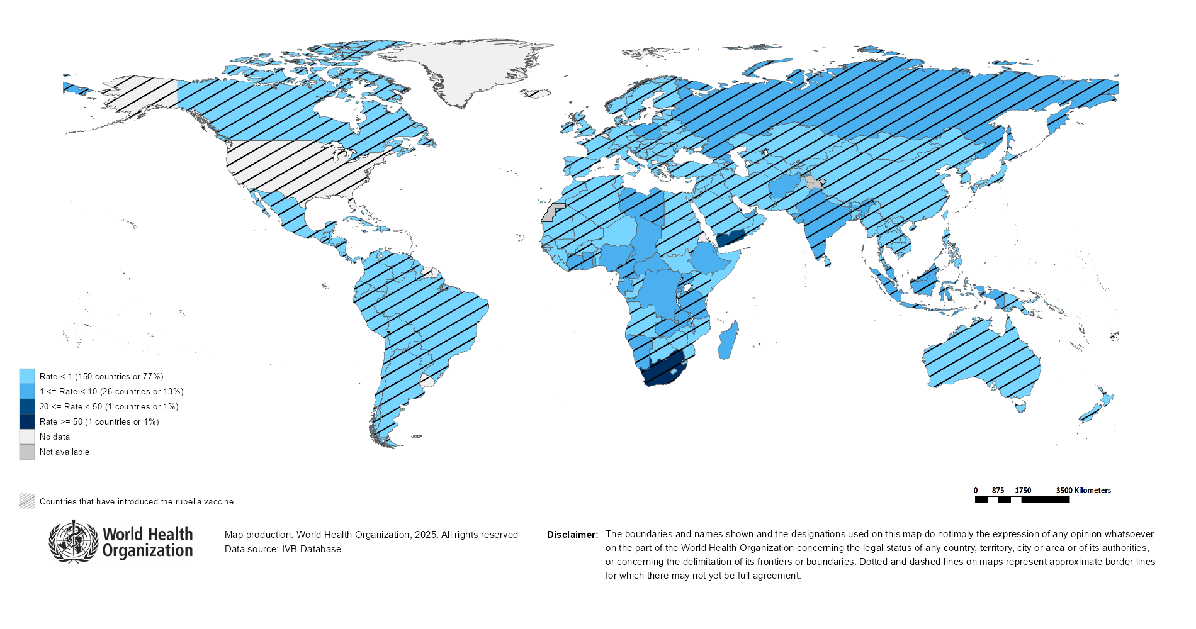
Rubella Incidence Rate per Million (12M period)
Highest incidence rates | Highest incidence rates | Highest incidence rates
Country | Cases | Rate
South Africa | 3910 | 61.09
Yemen | 1764 | 43.47
Chad | 167 | 8.23
DR Congo | 827 | 7.57
Central African Republic | 23 | 4.31
Djibouti | 5 | 4.28
Ethiopia | 474 | 3.59
Gabon | 9 | 3.54
Nigeria | 774 | 3.33
Namibia | 9 | 2.97
Notes: Based on data received 2025-12 - Surveillance data from 2025-05 to 2025-10 - Incidence: Number of cases / population * 1,000,000 - Population data: World population prospects, 2019 revision

Slide 49
Disclaimer
This document contains data provided to WHO by member states. Note that some member states only provide aggregate data to WHO, and for these, we are unable to generate a country profile. Some member states report all cases at one time point for the entire year, and thus epidemiologic curves generated are not accurate and a reporting artifact. For some countries, cases are reported by age category, not by exact age in months and/or years. Thus, age distribution/incidence is approximate. Cases classified as pending by countries are classified at WHO as clinically compatible at this time, and thus numbers might different between data shown here and provided by the member state or WHO country/regional offices.
*UN population data is used as the denominator for calculating incidence.

Slide 50
Rubella cases (AFR)
AFR Rubella Case Distribution (January 2023-December 2025)
Top 10 countries (last 12 M) | Top 10 countries (last 12 M) | Top 10 countries (last 12 M) | Top 10 countries (last 12 M)
Country | RCV in RI | Cases | % of Total
South Africa | 2024 | 2366 | 45
DR Congo | No | 911 | 17
Nigeria | No | 743 | 14
Ethiopia | No | 459 | 9
Others | - | 316 | 6
Chad | No | 167 | 3
United Republic of Tanzania | 2014 | 111 | 2
Ghana | 2013 | 64 | 1
Madagascar | No | 63 | 1
Malawi | 2017 | 59 | 1
Uganda | 2019 | 45 | 1
2023
2024
2025
4,000
3,000
(lab + epi-linked + clinical)
Number of cases
2,000
1,000
0
Jan
Feb
Mar
Apr
May
Jun
Jul
Aug
Sep
Oct
Nov
Dec
Jan
Feb
Mar
Apr
May
Jun
Jul
Aug
Sep
Oct
Nov
Dec
Jan
Feb
Mar
Apr
May
Jun
Jul
Aug
Sep
Oct
Nov
Dec
Introduced less than 5 years ago
Introduced more than 5 years ago
Not introduced in EPI
(after 2020)
(2020 and before)
AFR Age distribution of Rubella IgM+ cases by vaccine introduction status in the National EPI Programme (last 12 Months)
400
(IgM+ only)
Number of cases
200
0
0
10
20
30
40
Age at onset (in years)
Rubella vaccine introduced before 1 January 2025
Rubella vaccine not introduced before 1 January 2025
Notes: Based on data received 2025-12 Data Source: IVB Database.

Slide 51
Rubella cases: Democratic Republic of the Congo
ELIMINATION STATUS:
ENDEMIC
2022
2023
2024
2025
Total = 1,239 cases
Total = 594 cases
Total = 300 cases
Total = 889 cases
400
Rubella cases
200
0
Jan
Feb
Mar
Apr
May
Jun
Jul
Aug
Sep
Oct
Nov
Dec
Jan
Feb
Mar
Apr
May
Jun
Jul
Aug
Sep
Oct
Nov
Dec
Jan
Feb
Mar
Apr
May
Jun
Jul
Aug
Sep
Oct
Nov
Dec
Jan
Feb
Mar
Apr
May
Jun
Jul
Aug
Sep
Oct
Nov
Dec
Clinical
Epi
Lab
Age distribution, sex and incidence (Last 12 months)
WHO/UNICEF Coverage Estimates (WUENIC)
400
100
300
20
80
200
Incidence rate per M
60
Number of cases
10
% Coverage
100
40
0
0
20
<1 yr
1-4 yrs
5-9 yrs
10-14 yrs
15-24 yrs
25-39 yrs
40+ yrs
0
Age at onset (in years)
2000
2001
2002
2003
2004
2005
2006
2007
2008
2009
2010
2011
2012
2013
2014
2015
2016
2017
2018
2019
2020
2021
2022
2023
2024
Incidence
Male
Female
Unknown
RCV1

Slide 52
Rubella cases: Ethiopia
ELIMINATION STATUS:
ENDEMIC
300
2022
2023
2024
2025
Total = 824 cases
Total = 930 cases
Total = 242 cases
Total = 438 cases
200
Rubella cases
100
0
Jan
Feb
Mar
Apr
May
Jun
Jul
Aug
Sep
Oct
Nov
Dec
Jan
Feb
Mar
Apr
May
Jun
Jul
Aug
Sep
Oct
Nov
Dec
Jan
Feb
Mar
Apr
May
Jun
Jul
Aug
Sep
Oct
Nov
Dec
Jan
Feb
Mar
Apr
May
Jun
Jul
Aug
Sep
Oct
Nov
Dec
Clinical
Epi
Lab
Age distribution, sex and incidence (Last 12 months)
WHO/UNICEF Coverage Estimates (WUENIC)
200
15
100
150
10
80
Number of cases
Incidence rate per M
60
100
% Coverage
50
5
40
0
0
20
<1 yr
1-4 yrs
5-9 yrs
10-14 yrs
15-24 yrs
25-39 yrs
40+ yrs
0
Age at onset (in years)
2000
2001
2002
2003
2004
2005
2006
2007
2008
2009
2010
2011
2012
2013
2014
2015
2016
2017
2018
2019
2020
2021
2022
2023
2024
Incidence
Male
Female
Unknown
RCV1

Slide 53
Rubella cases: Nigeria
ELIMINATION STATUS:
ENDEMIC
2022
2023
2024
2025
300
Total = 895 cases
Total = 740 cases
Total = 651 cases
Total = 732 cases
200
Rubella cases
100
0
Jan
Feb
Mar
Apr
May
Jun
Jul
Aug
Sep
Oct
Nov
Dec
Jan
Feb
Mar
Apr
May
Jun
Jul
Aug
Sep
Oct
Nov
Dec
Jan
Feb
Mar
Apr
May
Jun
Jul
Aug
Sep
Oct
Nov
Dec
Jan
Feb
Mar
Apr
May
Jun
Jul
Aug
Sep
Oct
Nov
Dec
SIA
Clinical
Epi
Lab
250
Age distribution, sex and incidence (Last 12 months)
WHO/UNICEF Coverage Estimates (WUENIC)
10.0
100
200
7.5
80
150
5.0
Number of cases
Incidence rate per M
60
100
% Coverage
50
2.5
40
0
0.0
20
<1 yr
1-4 yrs
5-9 yrs
10-14 yrs
15-24 yrs
25-39 yrs
40+ yrs
0
Age at onset (in years)
2000
2001
2002
2003
2004
2005
2006
2007
2008
2009
2010
2011
2012
2013
2014
2015
2016
2017
2018
2019
2020
2021
2022
2023
2024
Incidence
Male
Female
Unknown
RCV1

Slide 54
Rubella cases (EMR)
EMR Rubella Case Distribution (January 2023-December 2025)
Top 10 countries (last 12 M) | Top 10 countries (last 12 M) | Top 10 countries (last 12 M) | Top 10 countries (last 12 M)
Country | RCV in RI | Cases | % of Total
Yemen | 2015 | 1635 | 77
Pakistan | 2022 | 242 | 11
Afghanistan | No | 108 | 5
Sudan | 2024 | 30 | 1
Iraq | 1989 | 22 | 1
Others | - | 19 | 1
Saudi Arabia | 1982 | 19 | 1
Libya | 1993 | 14 | 1
Syrian Arab Republic | 1999 | 13 | 1
United Arab Emirates | 1985 | 13 | 1
Tunisia | 2012 | 9 | 0
2023
2024
2025
400
300
(lab + epi-linked + clinical)
Number of cases
200
100
0
Jan
Feb
Mar
Apr
May
Jun
Jul
Aug
Sep
Oct
Nov
Dec
Jan
Feb
Mar
Apr
May
Jun
Jul
Aug
Sep
Oct
Nov
Dec
Jan
Feb
Mar
Apr
May
Jun
Jul
Aug
Sep
Oct
Nov
Dec
Introduced less than 5 years ago
Introduced more than 5 years ago
Not introduced in EPI
(after 2020)
(2020 and before)
EMR Age distribution of Rubella IgM+ cases by vaccine introduction status in the National EPI Programme (last 12 Months)
400
300
(IgM+ only)
200
Number of cases
100
0
0
10
20
30
40
Age at onset (in years)
Rubella vaccine introduced before 1 January 2025
Rubella vaccine not introduced before 1 January 2025
Notes: Based on data received 2025-12 Data Source: IVB Database.

Slide 55
Rubella cases: Pakistan
ELIMINATION STATUS:
ENDEMIC
2022
2023
2024
2025
60
Total = 309 cases
Total = 236 cases
Total = 330 cases
Total = 236 cases
40
Rubella cases
20
0
Jan
Feb
Mar
Apr
May
Jun
Jul
Aug
Sep
Oct
Nov
Dec
Jan
Feb
Mar
Apr
May
Jun
Jul
Aug
Sep
Oct
Nov
Dec
Jan
Feb
Mar
Apr
May
Jun
Jul
Aug
Sep
Oct
Nov
Dec
Jan
Feb
Mar
Apr
May
Jun
Jul
Aug
Sep
Oct
Nov
Dec
Clinical
Epi
Lab
Age distribution, sex and incidence (Last 12 months)
WHO/UNICEF Coverage Estimates (WUENIC)
100
90
80
10
60
Incidence rate per M
60
Number of cases
30
5
% Coverage
40
0
0
20
<1 yr
1-4 yrs
5-9 yrs
10-14 yrs
15-24 yrs
25-39 yrs
40+ yrs
0
Age at onset (in years)
2000
2001
2002
2003
2004
2005
2006
2007
2008
2009
2010
2011
2012
2013
2014
2015
2016
2017
2018
2019
2020
2021
2022
2023
2024
Incidence
Male
Female
Unknown
RCV1

Slide 56
Rubella cases (EUR)
EUR Rubella Case Distribution (January 2023-December 2025)
Top 10 countries (last 12 M) | Top 10 countries (last 12 M) | Top 10 countries (last 12 M) | Top 10 countries (last 12 M)
Country | RCV in RI | Cases | % of Total
Russian Federation | 2000 | 395 | 74
Poland | 1988 | 81 | 15
Türkiye | 2006 | 24 | 4
Ukraine | 2003 | 8 | 1
Germany | 1991 | 7 | 1
Others | - | 5 | 1
Sweden | 1982 | 4 | 1
Kazakhstan | 2004 | 3 | 1
Kyrgyzstan | 2001 | 3 | 1
Uzbekistan | 2006 | 3 | 1
Spain | 1978 | 2 | 0
2023
2024
2025
90
60
(lab + epi-linked + clinical)
Number of cases
30
0
Jan
Feb
Mar
Apr
May
Jun
Jul
Aug
Sep
Oct
Nov
Dec
Jan
Feb
Mar
Apr
May
Jun
Jul
Aug
Sep
Oct
Nov
Dec
Jan
Feb
Mar
Apr
May
Jun
Jul
Aug
Sep
Oct
Nov
Dec
Introduced more than 5 years ago
(2020 and before)
EUR Age distribution of Rubella IgM+ cases by vaccine introduction status in the National EPI Programme (last 12 Months)
20
15
(IgM+ only)
Number of cases
10
5
0
0
10
20
30
40
Age at onset (in years)
Rubella vaccine introduced before 1 January 2025
Rubella vaccine not introduced before 1 January 2025
Notes: Based on data received 2025-12 Data Source: IVB Database. Spikes in age-distribution curve are an artifact of reporting by age bands ( 0=<1 yrs, 2=1-4 yrs, 7=5-9 yrs, 12=10-14 yrs, 17=15-19 yrs, 25=20-29 yrs, 45=30+yrs) instead of by age from some member states.

Slide 57
Rubella cases (SEAR (excl. India))
SEAR (excl. India) Rubella Case Distribution (January 2023-December 2025)
Top 10 countries (last 12 M) | Top 10 countries (last 12 M) | Top 10 countries (last 12 M) | Top 10 countries (last 12 M)
Country | RCV in RI | Cases | % of Total
Bangladesh | 2012 | 102 | 79
Thailand | 1997 | 17 | 13
Myanmar | 2015 | 9 | 7
Nepal | 2013 | 1 | 1
2023
2024
2025
60
40
(lab + epi-linked + clinical)
Number of cases
20
0
Jan
Feb
Mar
Apr
May
Jun
Jul
Aug
Sep
Oct
Nov
Dec
Jan
Feb
Mar
Apr
May
Jun
Jul
Aug
Sep
Oct
Nov
Dec
Jan
Feb
Mar
Apr
May
Jun
Jul
Aug
Sep
Oct
Nov
Dec
Introduced more than 5 years ago
(2020 and before)
SEAR (excl. India) Age distribution of Rubella IgM+ cases by vaccine introduction status in the National EPI Programme (last 12 Months)
40
(IgM+ only)
Number of cases
20
0
0
10
20
30
40
Age at onset (in years)
Rubella vaccine introduced before 1 January 2025
Rubella vaccine not introduced before 1 January 2025
Notes: Based on data received 2025-12 Data Source: IVB Database.

Slide 58
Rubella cases (SEAR, India)
SEAR, India Rubella Case Distribution (January 2023-December 2025)
Top 10 countries (last 12 M) | Top 10 countries (last 12 M) | Top 10 countries (last 12 M) | Top 10 countries (last 12 M)
Country | RCV in RI | Cases | % of Total
India | 2018 | 2480 | 100
2023
2024
2025
300
200
(lab + epi-linked + clinical)
Number of cases
100
0
Jan
Feb
Mar
Apr
May
Jun
Jul
Aug
Sep
Oct
Nov
Dec
Jan
Feb
Mar
Apr
May
Jun
Jul
Aug
Sep
Oct
Nov
Dec
Jan
Feb
Mar
Apr
May
Jun
Jul
Aug
Sep
Oct
Nov
Dec
Introduced more than 5 years ago
(2020 and before)
SEAR, India Age distribution of Rubella IgM+ cases by vaccine introduction status in the National EPI Programme (last 12 Months)
600
400
(IgM+ only)
Number of cases
200
0
0
10
20
30
40
Age at onset (in years)
Rubella vaccine introduced before 1 January 2025
Rubella vaccine not introduced before 1 January 2025
Notes: Based on data received 2025-12 Data Source: IVB Database.

Slide 59
Rubella cases: India
ELIMINATION STATUS:
ENDEMIC
2022
2023
2024
2025
500
Total = 2,559 cases
Total = 2,930 cases
Total = 2,540 cases
Total = 2,291 cases
400
300
Rubella cases
200
100
0
Jan
Feb
Mar
Apr
May
Jun
Jul
Aug
Sep
Oct
Nov
Dec
Jan
Feb
Mar
Apr
May
Jun
Jul
Aug
Sep
Oct
Nov
Dec
Jan
Feb
Mar
Apr
May
Jun
Jul
Aug
Sep
Oct
Nov
Dec
Jan
Feb
Mar
Apr
May
Jun
Jul
Aug
Sep
Oct
Nov
Dec
Clinical
Epi
Lab
Age distribution, sex and incidence (Last 12 months)
WHO/UNICEF Coverage Estimates (WUENIC)
30
100
750
80
500
20
Number of cases
Incidence rate per M
60
250
10
% Coverage
40
0
0
20
<1 yr
1-4 yrs
5-9 yrs
10-14 yrs
15-24 yrs
25-39 yrs
40+ yrs
0
Age at onset (in years)
2000
2001
2002
2003
2004
2005
2006
2007
2008
2009
2010
2011
2012
2013
2014
2015
2016
2017
2018
2019
2020
2021
2022
2023
2024
Incidence
Male
Female
Unknown
RCV1

Slide 60
Rubella cases (WPR)
WPR Rubella Case Distribution (January 2023-December 2025)
Top 10 countries (last 12 M) | Top 10 countries (last 12 M) | Top 10 countries (last 12 M) | Top 10 countries (last 12 M)
Country | RCV in RI | Cases | % of Total
Indonesia | 2018 | 713 | 53
China | 2008 | 422 | 31
Philippines | 2010 | 109 | 8
Malaysia | 2004 | 82 | 6
Japan | 1995 | 15 | 1
Cambodia | 2013 | 5 | 0
Lao People's Democratic Republic | 2012 | 3 | 0
Viet Nam | 2015 | 1 | 0
2023
2024
2025
150
100
(lab + epi-linked + clinical)
Number of cases
50
0
Jan
Feb
Mar
Apr
May
Jun
Jul
Aug
Sep
Oct
Nov
Dec
Jan
Feb
Mar
Apr
May
Jun
Jul
Aug
Sep
Oct
Nov
Dec
Jan
Feb
Mar
Apr
May
Jun
Jul
Aug
Sep
Oct
Nov
Dec
Introduced more than 5 years ago
(2020 and before)
WPR Age distribution of Rubella IgM+ cases by vaccine introduction status in the National EPI Programme (last 12 Months)
300
200
(IgM+ only)
Number of cases
100
0
0
10
20
30
40
Age at onset (in years)
Rubella vaccine introduced before 1 January 2025
Rubella vaccine not introduced before 1 January 2025
Notes: Based on data received 2025-12 Data Source: IVB Database.

Slide 61
Rubella cases: Indonesia
ELIMINATION STATUS:
ENDEMIC
2022
2023
2024
2025
150
Total = 755 cases
Total = 477 cases
Total = 457 cases
Total = 702 cases
100
Rubella cases
50
0
Jan
Feb
Mar
Apr
May
Jun
Jul
Aug
Sep
Oct
Nov
Dec
Jan
Feb
Mar
Apr
May
Jun
Jul
Aug
Sep
Oct
Nov
Dec
Jan
Feb
Mar
Apr
May
Jun
Jul
Aug
Sep
Oct
Nov
Dec
Jan
Feb
Mar
Apr
May
Jun
Jul
Aug
Sep
Oct
Nov
Dec
Clinical
Epi
Lab
Age distribution, sex and incidence (Last 12 months)
WHO/UNICEF Coverage Estimates (WUENIC)
50
100
200
40
150
80
30
Number of cases
Incidence rate per M
60
100
20
% Coverage
50
10
40
0
0
20
<1 yr
1-4 yrs
5-9 yrs
10-14 yrs
15-24 yrs
25-39 yrs
40+ yrs
0
Age at onset (in years)
2000
2001
2002
2003
2004
2005
2006
2007
2008
2009
2010
2011
2012
2013
2014
2015
2016
2017
2018
2019
2020
2021
2022
2023
2024
Incidence
Male
Female
Unknown
RCV1

Slide 62

Distribution of rubella genotypes (last 12 months)
Data Source: RUBENS2 database (Genotypes) and IVB Database (Incidence) as of 2025-12-10 and covering the period between 2024-11 and 2025-10 - Pie charts proportional to the number of sequenced viruses

Slide 63
Laboratory

Slide 64
Measles and Rubella IgM Data Summary
2025
Region | Member States* | Specimens received | Measles tested | Measles positive n(%) | Measles equivocal n(%) | Measles negative n(%) | Rubella tested | Rubella positive n(%) | Rubella equivocal n(%) | Rubella negative n(%)
AFR | 45/47 | 69,684 | 59,409 | 16,720 (28) | 1,107 (2) | 41,582 (70) | 46,428 | 3,470 (7) | 779 (2) | 42,179 (91)
AMR | 26/35 | 12,694 | 12,270 | 1,723 (14) | 317 (3) | 10,230 (83) | 11,757 | 323 (3) | 144 (1) | 11,290 (96)
EMR | 20/21 | 77,773 | 68,095 | 27,283 (40) | 61 (0) | 40,751 (60) | 59,641 | 1,052 (2) | 67 (0) | 58,522 (98)
EUR | 43/53 | 38,757 | 35,501 | 16,451 (46) | 142 (0) | 20,206 (57) | 16,174 | 2,754 (17) | 150 (1) | 13,102 (81)
SEAR | 10/10 | 76,339 | 75,085 | 6,961 (9) | 786 (1) | 67,311 (90) | 74,766 | 2,364 (3) | 562 (1) | 71,832 (96)
WPR | 26/28 | 55,902 | 53,610 | 15,119 (28) | 1,039 (2) | 37,408 (70) | 42,577 | 1,236 (3) | 242 (1) | 41,094 (97)
Total | 170/194 | 331,149 | 303,970 | 84,257 (28) | 3,452 (1) | 217,488 (72) | 251,343 | 11,199 (4) | 1,944 (1) | 238,019 (95)
2024
Region | Member States* | Specimens received | Measles tested | Measles positive n(%) | Measles equivocal n(%) | Measles negative n(%) | Rubella tested | Rubella positive n(%) | Rubella equivocal n(%) | Rubella negative n(%)
AFR | 43/47 | 120,445 | 109,377 | 19,102 (17) | 1,068 (1) | 61,018 (56) | 95,315 | 14,882 (16) | 465 (0) | 51,744 (54)
AMR | 29/35 | 8,290 | 8,838 | 328 (4) | 194 (2) | 8,316 (94) | 7,902 | 164 (2) | 82 (1) | 7,656 (97)
EMR | 21/21 | 116,666 | 98,271 | 38,273 (39) | 129 (0) | 59,869 (61) | 90,051 | 1,468 (2) | 77 (0) | 88,506 (98)
EUR | 46/53 | 161,223 | 139,453 | 79,030 (57) | 407 (0) | 54,603 (39) | 57,910 | 1,375 (2) | 363 (1) | 55,546 (96)
SEAR | 10/10 | 107,744 | 105,794 | 13,309 (13) | 1,097 (1) | 91,234 (86) | 101,687 | 2,551 (3) | 691 (1) | 98,445 (97)
WPR | 26/28 | 46,024 | 44,029 | 11,240 (26) | 3,086 (7) | 33,538 (76) | 33,773 | 1,137 (3) | 2,437 (7) | 32,463 (96)
Total | 175/194 | 560,392 | 505,762 | 161,282 (32) | 5,981 (1) | 308,578 (61) | 386,638 | 21,577 (6) | 4,115 (1) | 334,360 (86)
Notes: Based on data received 2025-12 - * Member States Reporting / Total Member States in Region

Slide 65
Supplementary Immunization Activities

Slide 66
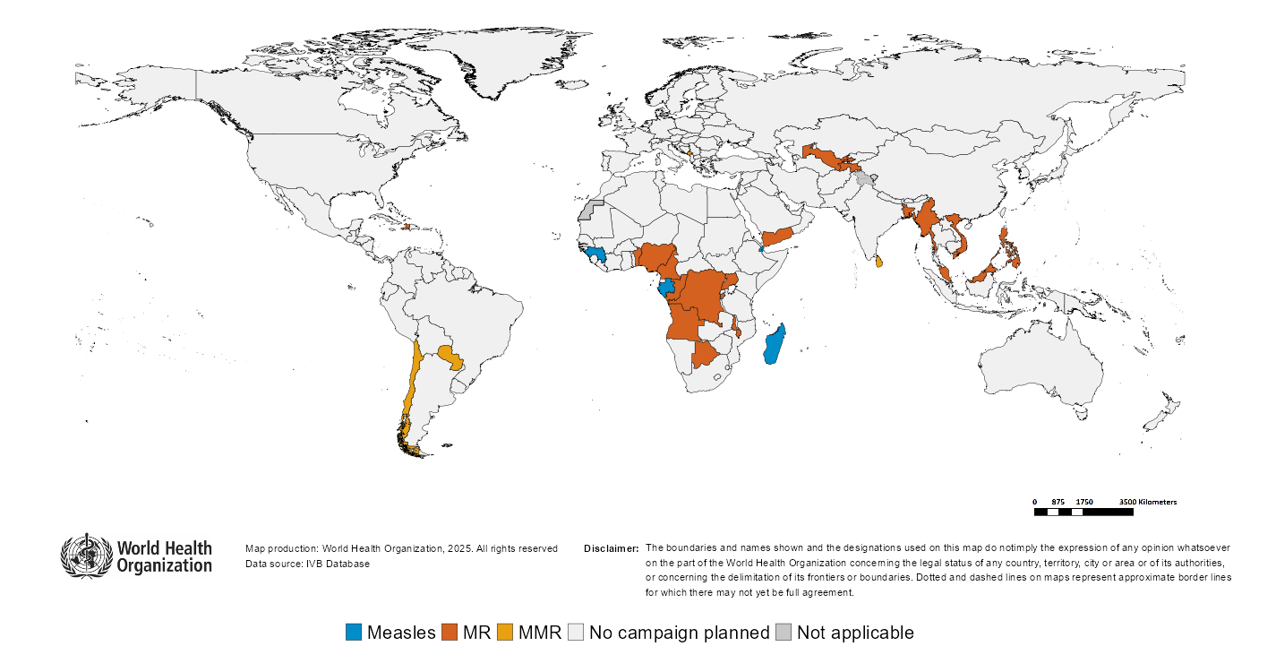
Upcoming MMR, MR and Measles campaigns (2025-2026)

Slide 67
Upcoming MMR, MR and Measles campaigns (2025-2026)
Year | Region | Name | Type | Intervention | StartDate | Status | Age Group(s) | Extent | Target
2025 |  | Uzbekistan | OR | MR | 2025-01-?? | Planned | 6 M-15 Y | NATIONAL | 2237512
2025 | AFR | Congo | FollowUp | MR | 2025-12-?? | Planned | 9-59 M | NATIONAL | 927595
2025 | AMR | Turks and Caicos Islands | VaccinationWeek | MMR | 2025-04-?? | Planned | 5-14 Y | NATIONAL | 100
2025 | AMR | Chile | Campaign | MMR | 2025-08-?? | Planned | School-age | NATIONAL | 250000
2025 | AMR | - | Campaign | MMR | 2025-NA-?? | Planned | 15-45 Y | NATIONAL | -
2025 | AMR | Saint Kitts and Nevis | Vaccination Week | MMR | 2025-NA-?? | Planned | 12-59 M | NATIONAL | -
2025 | SEAR | Myanmar | CatchUp-SIA | MR | 2025-01-?? | Planned | 9-59 M | SUBNATIONAL | 255807
2025 | SEAR | Sri Lanka | CatchUp-SIA | MMR | 2025-05-?? | Planned | Risk groups | NATIONAL | -
2025 | WPR | Viet Nam | OR | MR | 2025-01-?? | Planned | 6 M-15 Y | NATIONAL | 2170542
2025 | WPR | Malaysia | Preventive | MR | 2025-08-?? | Planned | 6-59 M | NATIONAL | 2168900
2025 | WPR | China, Macao SAR | - | MMR | 2025-NA-?? | Planned | Risk groups | NATIONAL | 700
2026 | AFR | Nigeria | FollowUp | MR | 2026-01-20 | Planned | 9-59 M | SUBNATIONAL | 43599567
2026 | AFR | Democratic Republic of the Congo | CatchUp | MR | 2026-02-?? | Planned | 6 M-14 Y | NATIONAL | 22303421
2026 | AFR | Democratic Republic of the Congo | CatchUp | MR | 2026-06-?? | Planned | 6 M-14 Y | NATIONAL | 24791774
2026 | AFR | Cameroon | FollowUp | MR | 2026-09-?? | Planned | 9-59 M | NATIONAL | 4345819
2026 | AFR | Burundi | FollowUp | MR | 2026-10-?? | Planned | 9-59 M | NATIONAL | 2446535
2026 | AFR | Guinea | FollowUp | MEASLES | 2026-10-?? | Planned | 9-59 M | NATIONAL | 4067987
2026 | AFR | Madagascar | FollowUp | MEASLES | 2026-10-?? | Planned | 9-59 M | NATIONAL | 4765314
2026 | AFR | Benin | Followup | MR | 2026-11-?? | Planned | 9-59 M | NATIONAL | 2136671
2026 | AFR | Angola | FollowUp | MR | 2026-NA-?? | Planned | 9-59 M | NATIONAL | 5983408
2026 | AFR | Botswana | FollowUp | MR | 2026-NA-?? | Planned | 9-59 M | NATIONAL | 223959
2026 | AFR | Gabon | FollowUp | MEASLES | 2026-NA-?? | Planned | 9-59 M | NATIONAL | 306528
2026 | AFR | Malawi | FollowUp | MR | 2026-NA-?? | Planned | 9-59 M | NATIONAL | 5850406
2026 | AFR | Uganda | FollowUp | MR | 2026-NA-?? | Planned | 9-59 M | NATIONAL | 7685529
2026 | AMR | Haiti | FollowUp | MR | 2026-06-?? | Planned | 9-59 M | NATIONAL | 1236480
2026 | AMR | Paraguay | Campaign | MMR | 2026-10-?? | Planned | 12-59 M | NATIONAL | 509698
2026 | EMR | Yemen | FollowUp | MR | 2026-09-?? | Planned | 9-59 M | NATIONAL | 4714060
2026 | EMR | Djibouti | FollowUp | MEASLES | 2026-NA-?? | Planned | 9-59 M | NATIONAL | 340185
2026 | EUR | Montenegro | CatchUp-SIA | MMR | 2026-04-?? | Planned | 1-15 Y | NATIONAL | 24000
2026 | EUR | Tajikistan | FollowUp | MR | 2026-10-?? | Planned | 9-59 M | SUBNATIONAL | 818399
2026 | SEAR | Bangladesh | FollowUp | MR | 2026-04-?? | Planned | 9 M-14 Y | NATIONAL | 19808176
2026 | SEAR | Myanmar | FollowUp | MR | 2026-11-?? | Planned | 9-59 M | NATIONAL | 2826984
2026 | WPR | Philippines | FollowUp | MR | 2026-NA-?? | Planned | 6-59 M | NATIONAL | 11922969

Slide 68
WHO Bulletins and Newsletters

